Slide 1
Curated Protein Information in the Saccharomyces Genome Database
Sage Hellerstedt
3/27/17

Slide 2
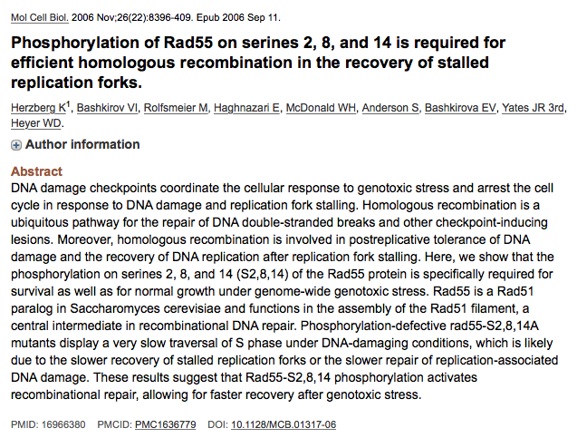
Post Translational Modification Data (PTM) Curation Strategy
1. Identify articles with PTM data
2. Data Extraction
Protein modified
Amino acid residue modified
Type of modification
Modifier (if known, e.g. kinase)
Strain background
Reference
PTM

Slide 3
PTM Annotation Metrics
Modification Type | Number of associated annotations
Phosphorylation | 34,188
Ubiquitination | 6,230
Succinylation | 1,344
Acetylation | 925
Methylation | 284
Palmitoylation | 28
Sumoylation | 26
Deacetylation | 19
Carbamidomethylation | 16
Dephosphorylation | 10
Butyrylation | 10
Ethylation | 10
*Numbers as of 10/19/16

Slide 4
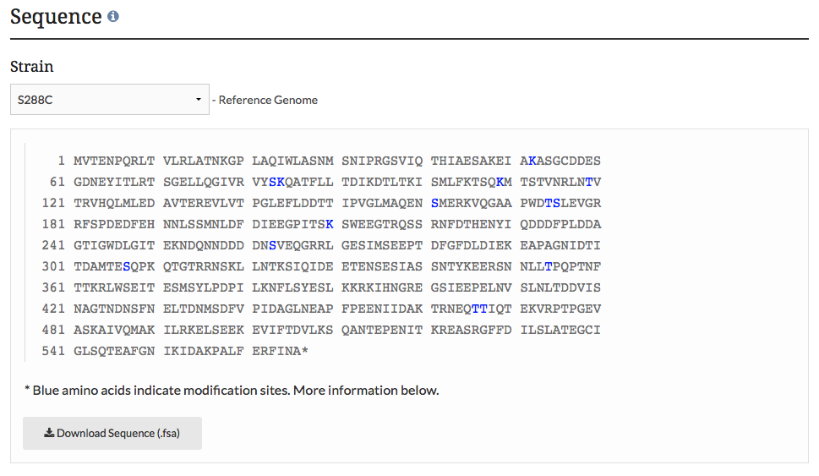
Data Display and Visualization
Example PTM data as displayed in sequence form on the MCD1 protein tab page:
Choose your strain
Amino Acid protein sequence with modified residues highlighted

Slide 5
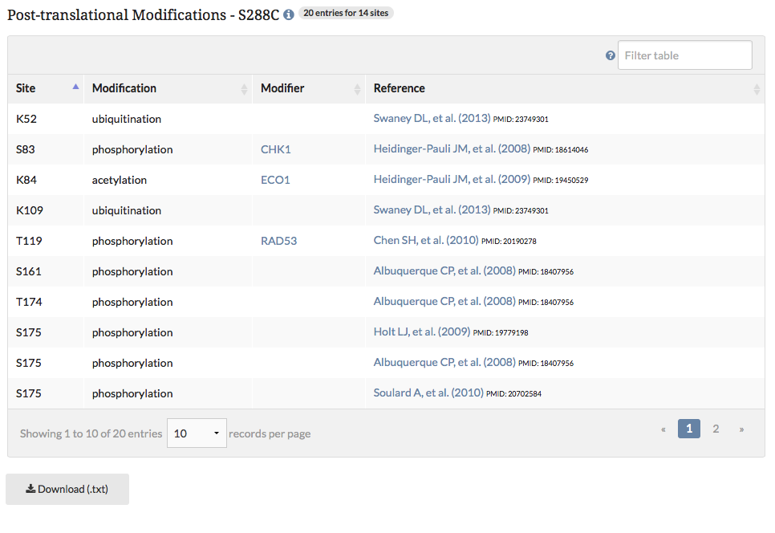
Data Display and Visualization
Example PTM data as displayed in tabular form on the MCD1 protein tab page:

Slide 6
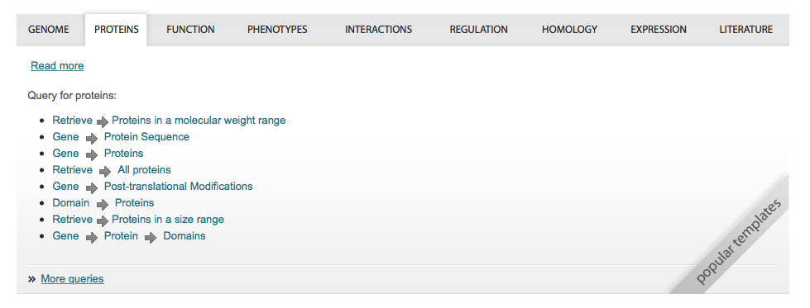
Data Display and Visualization
Query and retrieve PTM data from the YeastMine template (yeastmine.yeastgenome.org)

Slide 7
PTM Workflow Summary and Future Directions
Monthly new PTM data
Improvement of data visualization (e.g. color changes or icons)
Overlay on SGD variant viewer tool (www.yeastgenome.org/variantviewer)

Slide 8
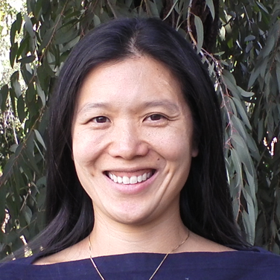
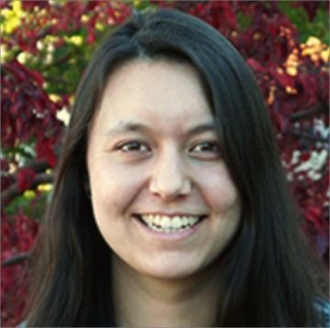
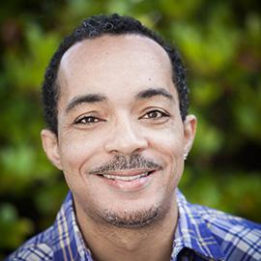
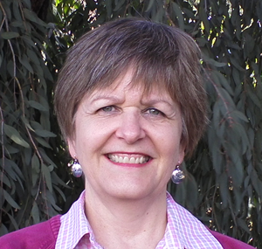
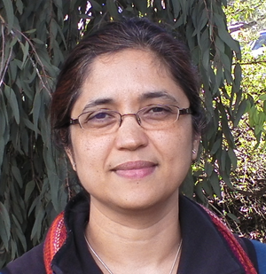
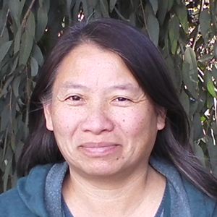
Acknowledgments
J. Michael Cherry
Stacia Engel
Edith Wong
Marek Skrzypek
Rob Nash
Olivia Lang
Kevin MacPherson
Terry Jackson
Gail Binkley
Kalpana Karra
Pedro Assis
Shuai Weng
Travis Sheppard
Matt Simison
Stuart Miyasato
Funding: This work is supported by a grant from the National Human Genome Research Institute at the United States National Institutes of Health (U41 HG001315).

Slide 9
Questions?

