Slide 1
Data analysis: GO tools and YeastMine, use-case examples

Slide 2
How to leverage data rich SGD!
About 93,000 GO annotations (manual, HTP and computational)
About 135,000 phenotype annotations (manual and HTP)
About 338,000 physical (130K) and genetic (208K) interactions

Slide 3
Analysis entry points
Home page links
GO term pages (e.g. autophagy +/- child terms)
Phenotype observable-qualifier pairs (e.g. cell size: increased, or just observable
Interaction pages (Physical, Genetic, Intersection, All)
Notes:
Autophagy (GO:6914)
http://www.yeastgenome.org/phenotype/increased_cell_size/overview
http://www.yeastgenome.org/observable/cell_size/overview

Slide 4
GO Slim Mapper
Maps annotations of a group of genes to more general terms; bin them into broad categories
You complete a screen looking for mutants with altered sensitivity to a new drug (see: List2 GSM SGD P) and want to know based on the mutants identified what process is being affected.

Slide 5
GO Slim Mapper

Slide 6
GO Slim Mapper: Results

Slide 7
GO Term Finder
Searches for significant shared GO terms or parents of these terms, so you can figure out what these genes have in common.

Slide 8
GO Term Finder
Optional:
Step 3 Specify background set of genes
Step 4 Refine the Annotations used for calculation
Step 5 Select a p-value cutoff and/or toggle FDR

Slide 9
Batch GO Term Finder
http://go.princeton.edu/cgi-bin/GOTermFinder
Advantages:
process multiple gene lists in parallel
handles longer gene lists
large number of available organisms
Example, list of genes with a defect in endomembrane system morphology (List4_GTF_Princeton_P)

Slide 10
Batch GTF Results

Slide 11
YeastMine
A multifaceted search and retrieval environment that provides access to diverse data types.
Initiate searches, with a gene, list of genes. Results can be combined for further analysis
and saved or downloaded in customizable file formats.

Slide 12
Basic features
Templates: predefined queries. Filter by category or keyword:
genome
protein
function
interactions
regulation
homology
expression
literature
or keyword
“intron”
“sequence”

Slide 13
Template results page (1)
Add, re-arrange order, sort-order
Edit, add, remove a filter/constraint (e.g. just null vs filter)
Create new or add to existing list
Download results in various formats
Notes:
Chromosome/plasmid maintenance vs multiple (command) observables
Manage (Add description), change order, sort order (make standard name default)
Filter (add null to filter vs column summary filter)
Also pagination

Slide 14
Template results page (2)
Navigation aids
Column sort
Remove column
Toggle column visibility
Column summary

Slide 15
Lists and list operations
List creation
Create/add
Select genes
Name, describe, rename and share (MyMine) display
List operations
Intersection (DNA replication AND DNA repair or genes on ChrIV, that are inviable when deleted)
Union (DNA replication and/or DNA repair, two sets of interactions, etc.)
Subtract (DNA replication or DNA repair)
Asymmetric diff. (DNA replication minus repair;
DNA repair minus replication)

Slide 16
Use case: finding novel mitoribosomal proteins
I’m interested in the mitochondrial ribosome. Does it have
any as-yet-undiscovered subunits?
1. Find the known mitochondrial ribosomal proteins using YeastMine

Slide 17
2. Create a list of the results (90 genes)
3. Look for genes/proteins that interact with mt_ribosomal proteins
4. Create a list of 1,051 interacting genes/proteins.

Slide 18
Are any of the interacting genes uncharacterized?
create a list of uncharacterized genes
find the intersection between the list of uncharacterized genes and the list of mitochondrial ribosome-interacting genes
34 genes are uncharacterized

Slide 19
34 uncharacterized ORFs interact genetically or physically with known mitochondrial ribosomal proteins.
Mutation of a mt ribosomal subunit would block respiratory growth. Do any of these 34 genes exhibit this mutant phenotype?
create list of genes that confer a respiratory phenotype
find the intersection with the list of 34 uncharacterized ORFs

Slide 20
Three uncharacterized ORFs exhibit genetic or physical interactions with known mt ribosomal proteins AND block respiratory growth when mutated
Systematic name | Gene name | Name Description | ORF length | Description
YBL095W | MRX3 | Mitochondrial organization of gene expression | 813 | Protein that associates with mitochondrial ribosome; likely functions in cristae junction formation; the authentic, non-tagged protein is detected in highly purified mitochondria in high-throughput studies
YDL157C |  |  | 357 | Putative protein of unknown function; the authentic, non-tagged protein is detected in highly purified mitochondria in high-throughput studies
YPR109W |  |  | 885 | Predicted membrane protein; diploid deletion strain has high budding index

Slide 21
Explore a gene PRP8
Identify PRP8 interactors
Use OMIM to identify yeast genes orthologous to human genes involved in retinitis pigmentosa
Intersect the two lists to identify PRP8 interactors with orthologs involved in RP

Slide 22
1. Select template
2. Enter gene and show results
3. Remove columns, select manual annotations,
and save list of interacting genes/proteins
4. View enrichment

Slide 23
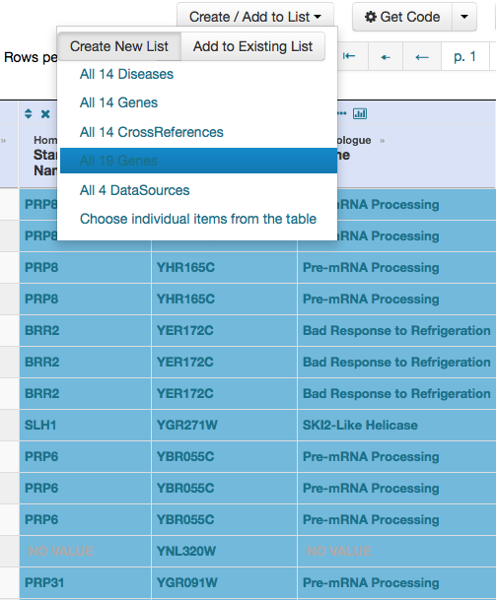
5. Now go backwards from human disease to human genes to yeast orthologs. Select “OMIM Disease Phenotype -> human gene(s) -> yeast homolog(s)” and enter “retinitis pigmentosa”
Create a second list of yeast orthologs
of human genes associated with RP
6. Perform an inverse selection using column
summary to remove “LEBER CONGENITAL …“

Slide 24
8. Now intersect the two lists (PRP8 interactors and RP orthologs)
In fact there is evidence that these 3 proteins are associated with Prp8p, as part of the U4/U6-U5 tri-snRNP spliceosome complex!

Slide 25
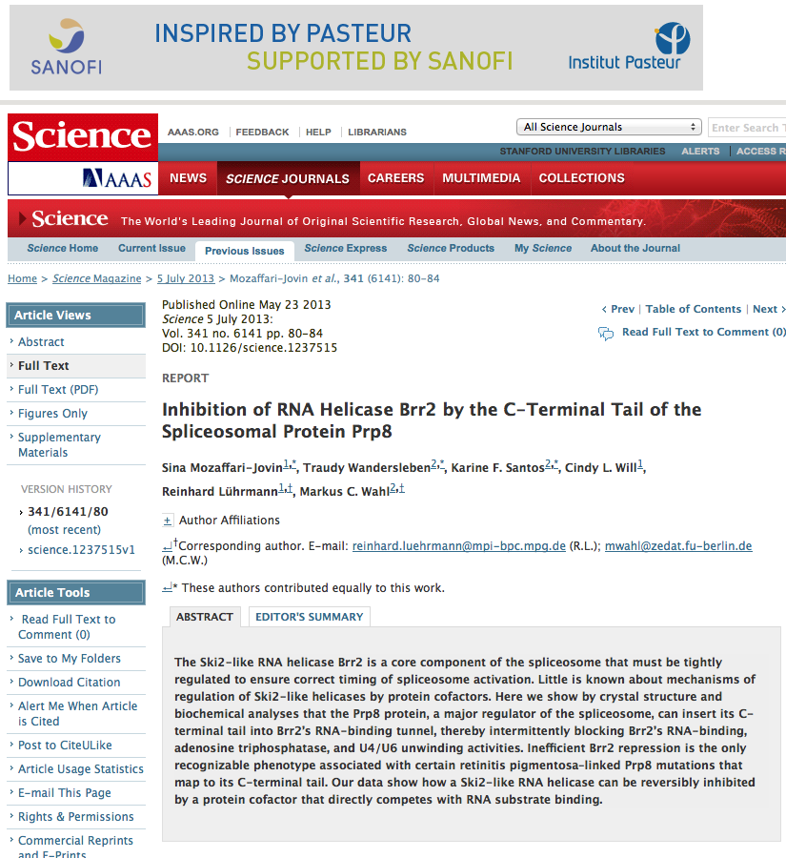
Prp8p inhibits Brr2p but not RP mutants.

Slide 26
Make your own query
Start in QueryBuilder:
select a data type: ORF
constrain to a chromosome: chrI
constrain qualifier: not dubious
show: standard name, systematic name, primary DBID
Can run query (show results)
Export XML (share with another)
Save Query (name it for later run, edit or export in MyMine)

