Slide 1
From one to many: expanding the Saccharomyces cerevisiae reference genome panel Stacia R. Engel Stanford University

Slide 2
From one to many…
1996: First yeast genome
2006: 2nd yeast genome
2016: 1000s of genome sequences

Slide 3
Expansion strategy
Freeze 1996 genome
Represent sequence variation
Phenotypes, allelic differences
Obtain select genome sequences
Assembly / annotation pipeline
Comparison tools for users
Panel of genomes

Slide 4
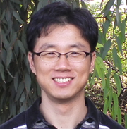
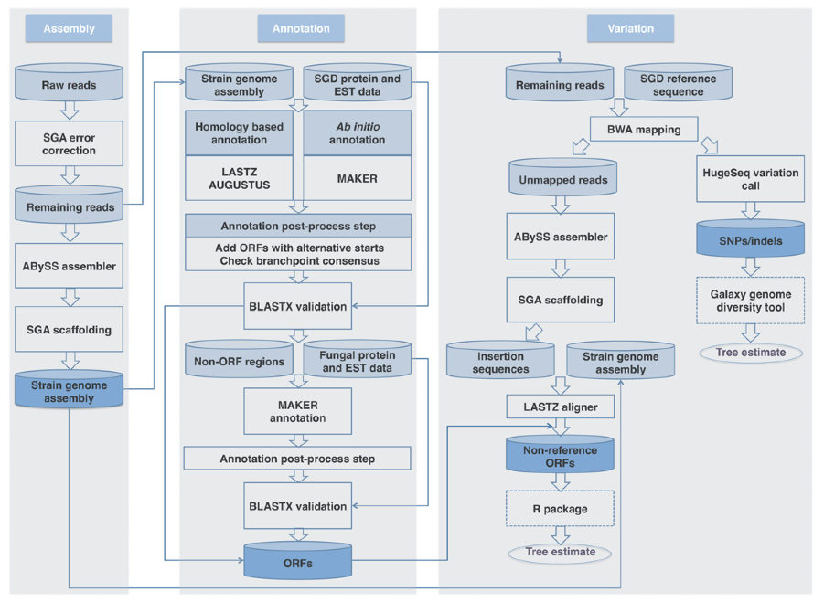
www.yeastgenome.org
Figure 1
Song et al. PLoS One 10:e0120671.
Giltae Song
Automated AGAPE output

Slide 6
www.yeastgenome.org
Figure 1
Song et al. PLoS One 10:e0120671.
Giltae Song
Automated AGAPE output

Slide 7
Expansion strategy
Freeze 1996 genome
Represent sequence variation
Phenotypes, allelic differences
Obtain select genome sequences
Assembly and annotation pipeline
Comparison tools for users
Panel of genomes
Curation
www.yeastgenome.org

Slide 8
www.yeastgenome.org
Figure 1
Song et al. PLoS One 10:e0120671.
Manual curation
Phase 1
Phase 2
Giltae Song
Starts and stops
Chromosomal elements
Automated AGAPE output
Multiple calls
RNA genes
Paralogs
Unmatched
Superfluous contigs
Omissions
Introns
Supercontigs
contig
sequences
Legend:
annotations
added
removed
edited
resolved

Slide 9
Curation strategy
Starts and stops
Multiple calls
Paralogs
RNA genes
Chromosomal elements
Superfluous contigs
Unmatched
Omissions
Legend:
added
edited
removed
resolved

Slide 10
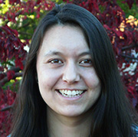
Manual curation
Phase 1
Phase 2
<2%
Starts and stops
Chromosomal elements
Olivia Lang
Automated AGAPE output
<1%
Multiple calls
RNA genes
15%
Paralogs
Unmatched
2%
1/2
Superfluous contigs
Omissions
18%
80% of ORFs
5%
Introns
Supercontigs
Sept. 2014
Sept. 2015
work in progress
Legend:
added
removed
edited
resolved
www.yeastgenome.org

Slide 11
Boundary differences
www.yeastgenome.org

Slide 12
Superfluous contigs
Strain | Original set | Curated set
CEN.PK | 389 | 189
D273-10B | 403 | 203
FL100 | 402 | 174
JK9-3d | 431 | 197
RM11-1a | 325 | 169
SEY6210 | 366 | 183
Σ1278b | 451 | 206
W303 | 415 | 236
X2180-1A | 409 | 212
Y55 | 413 | 198
Large number of redundant contigs (~50%)
Unnecessarily complicate annotation
Removed from sequence files
No genes called
Short overall length
Ambiguous sequence
www.yeastgenome.org

Slide 13
www.yeastgenome.org
Figure 1
Song et al. PLoS One 10:e0120671.
Manual curation
Phase 1
Phase 2
Giltae Song
Starts and stops
Chromosomal elements
Olivia Lang
Automated AGAPE output
Multiple calls
RNA genes
Paralogs
Unmatched
Superfluous contigs
Omissions
Introns
Supercontigs
contig
sequences
Legend:
annotations
added
removed
edited
resolved

Slide 14
Future directions…
Incorporate into database
Curated sequence files, annotations
Submit to NCBI’s GenBank
Primary sequence repository
Scripts on GitHub
Updates as needed
Expand panel further
Emerging, underserved areas of study

Slide 15
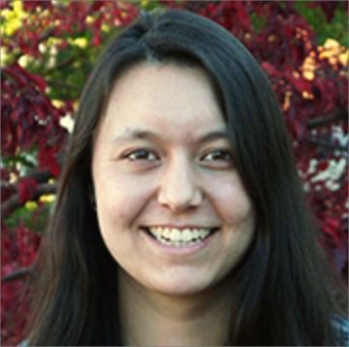
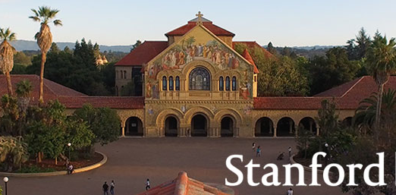
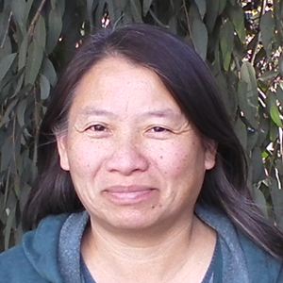
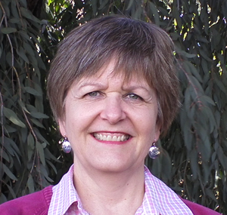
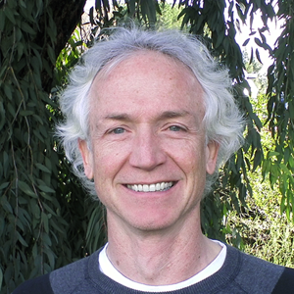
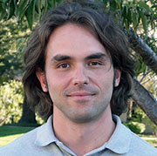
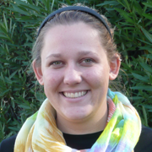
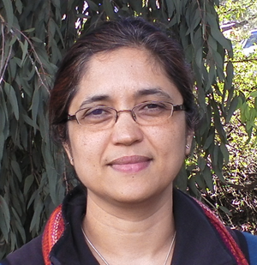
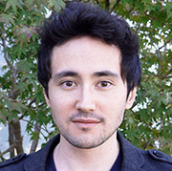
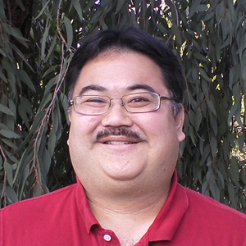
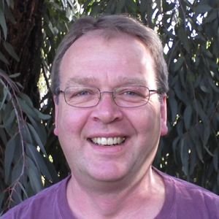
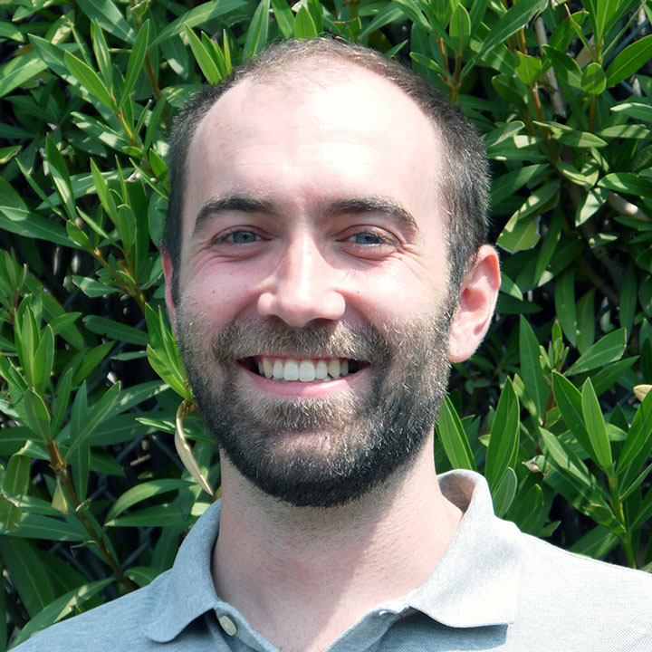
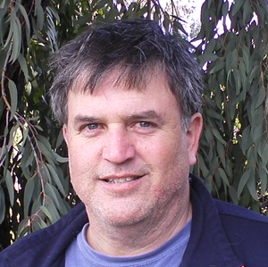
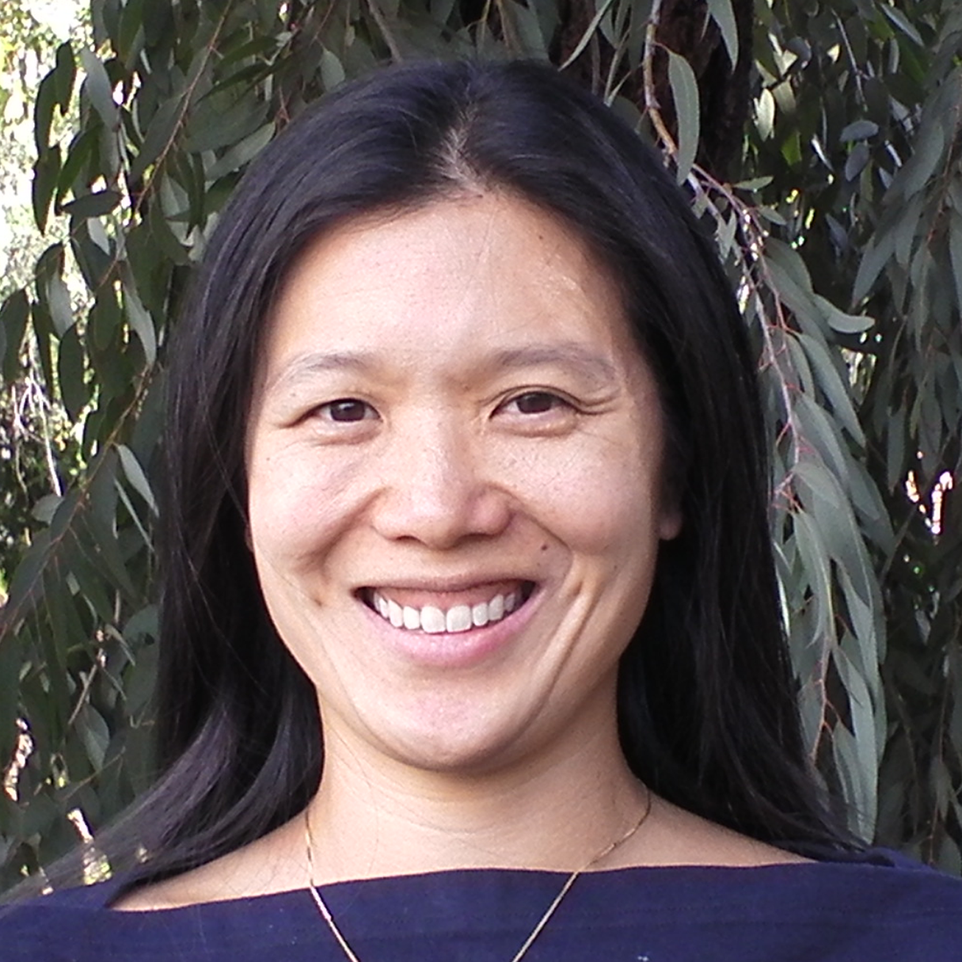
www.yeastgenome.org
Curation adds value
Olivia Lang
Giltae Song
Shuai Weng
Gail Binkley
J. Michael Cherry
Pedro Assis
Sage Hellerstedt
Kalpana Karra
Kevin MacPherson
Stuart Miyasato
Rob Nash
Travis Sheppard
Matt Simison
Marek Skrzypek
Edith Wong

