Slide 1
The Awesome Power of SGD
Stacia R. Engel • Stanford University • Yeast2022
#APOYG – Awesome Power of Yeast Genetics

Slide 2
Mike Cherry, PhD
Workshop/discussion agenda
SGD – basics, nomenclature, recent additions
Alliance of Genome Resources
Gene Ontology – data, tools
YeastMine data warehouse – templates, lists
Stacia Engel, PhD
yeastgenome.org
alliancegenome.org
geneontology.org
yeastmine.yeastgenome.org
Edith Wong, PhD
- - - - - SGD personnel at YGM2022 - - - - -
Suzi Aleksander
Rob Nash, PhD
Full list of SGD staff: https://cherrylab.stanford.edu/people/sgd-staff

Slide 3
SGD – basics, nomenclature, recent additions
Search & Explore
Genome version R64.3.1
New ncRNA systematic nomenclature
Updates to ‘legacy’ gene names
New ‘not in S288C’ systematic nomenclature
Updates to Reference Genome panel – in progress
Nomenclature conventions, qualifiers
Alleles and Allele pages
Updates to Interactions pages
New Homology pages
Disease pages
Extra bits - Supplementary data, published datasets, PubMed Central downloads
Submit Data
microPublication Biology
yeastgenome.org

Slide 4
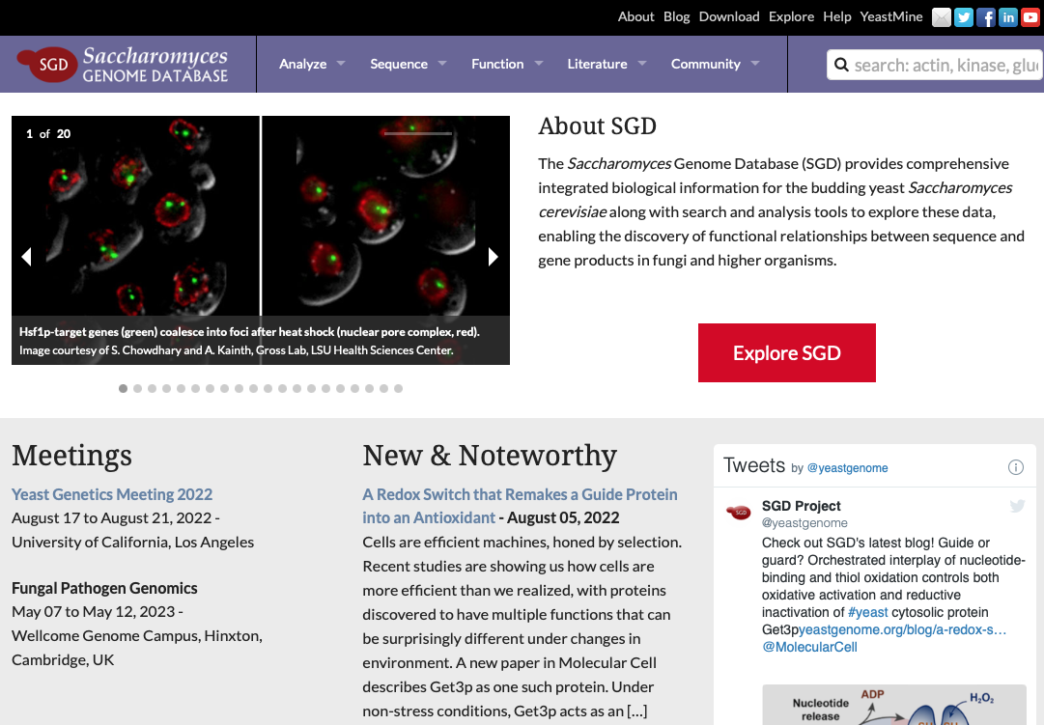
Search & Explore
quick search
Explore SGD
- returns all objects in database
SGD homepage www.yeastgenome.org

Slide 5
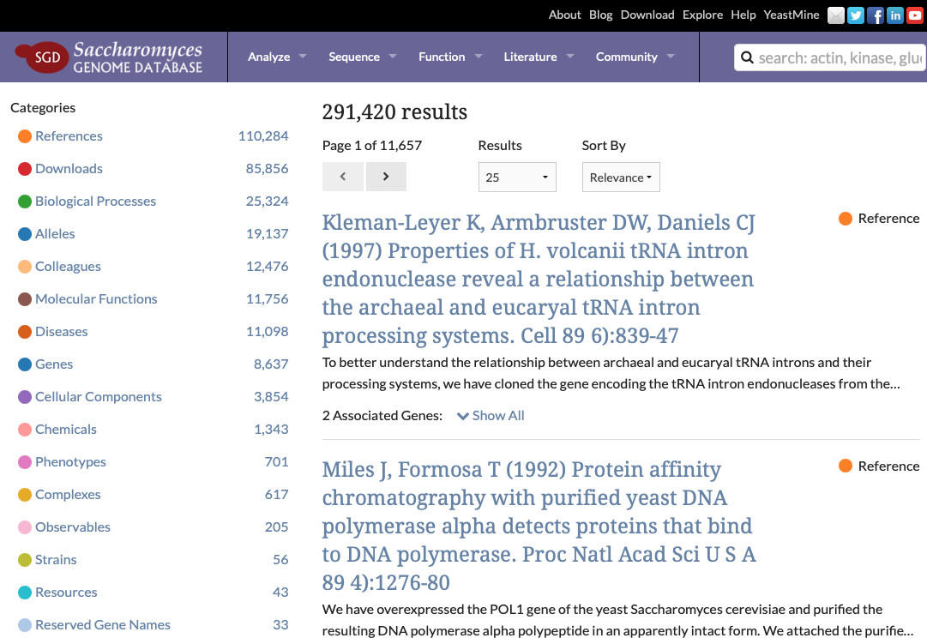
Search & Explore
Explore SGD
returns all objects in database
results updated daily
“Explore SGD” search result https://www.yeastgenome.org/search?q=&is_quick=true

Slide 6
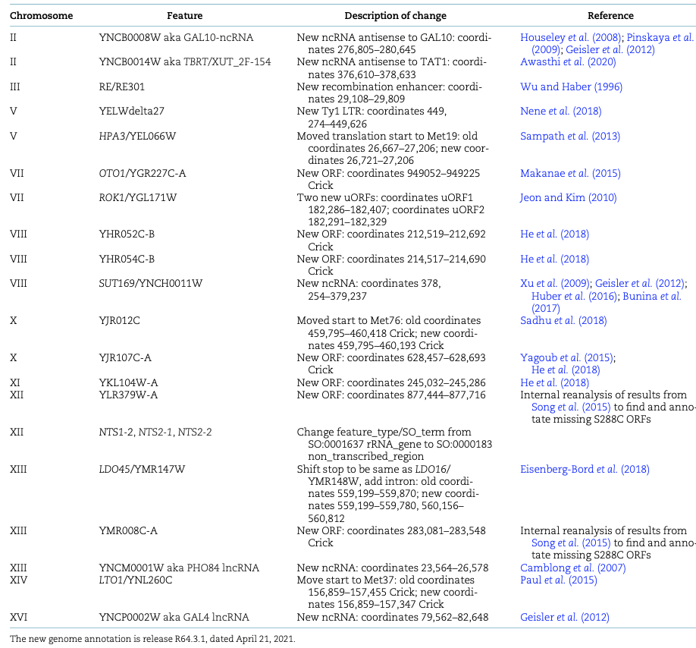
Genome version R64.3.1
New genome annotation
release R64.3.1
dated April 21, 2021
Updates and additions
7 new ORFs
5 new ncRNAs
2 new uORFs
New recombination enhancer
New LTR
3 ORFs: move start
1 ORF: move stop + new intron
Changed feature_type for NTS
No change to underlying sequence
https://wiki.yeastgenome.org/index.php/Details_of_2021_Reference_Genome_Annotation_Update_R64.3

Slide 7
Genome version R64.3.1
New genome annotation
release R64.3.1
dated April 21, 2021
No change to genomic sequence
Updates additions
7 new ORFs: OTO1/YGR227C-A, YHR052C-B, YHR054C-B, YJR107C-A, YKL104W-A, YLR379W-A, YMR008C-A
5 new ncRNAs: GAL10-ncRNA, TBRT/XUT_2F-154, SUT169, PHO84 lncRNA, GAL4 lncRNA
2 new uORFs for ROK1/YGL171W
New recombination enhancer: RE
New LTR: YELWdelta27
3 ORFs with shifted translation starts: HPA3/YEL066W, YJR012C, LTO1/YNL260C
1 ORF with shifted translation stop plus new intron: LDO45/YMR147W
Changed feature_type (and SO_term) for non-transcribed spacers: NTS1-2, NTS2-1, NTS2-2
https://wiki.yeastgenome.org/index.php/Details_of_2021_Reference_Genome_Annotation_Update_R64.3

Slide 8
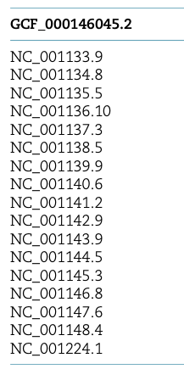
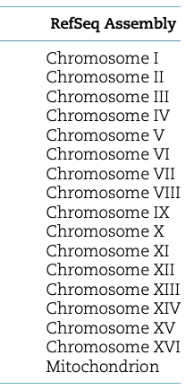
Genome version R64.3.1
NCBI RefSeq accession numbers for Saccharomyces cerevisiae S288C
reference genome version R64.3.1
To find these records:
Search SGD for ‘S288C’ to find strain page
https://www.yeastgenome.org/strain/S288C
Search NCBI for ‘S288C’
https://www.ncbi.nlm.nih.gov/genome/?term=S288C
https://wiki.yeastgenome.org/index.php/Details_of_2021_Reference_Genome_Annotation_Update_R64.3

Slide 9
Genome version R64.3.1 - New ncRNA systematic nomenclature
New systematic nomenclature for yeast ncRNAs – 430 genes
tRNA, snoRNA, rRNA, ncRNA, snRNA, telomerase RNA
Similar to, but distinct from, that used for ORFs
Four uppercase letters, a four-digit number, and another letter:
Y for “Yeast”
NC for “noncoding”
A-Q for the chromosome on which the ncRNA gene resides
“A” is chromosome I, “B” is chromosome II, up to “P” for chromosome XVI
“Q” for the mitochondrial chromosome
Four-digit number corresponding to sequential order of ncRNA gene on the chromosome starting from the left telomere and counting toward the right telomere
W or C indicating whether ncRNA gene is encoded on “Watson” or “Crick” strand
“Watson” runs 5’ to 3’ from left telomere to right telomere
“Crick” runs 3’ to 5’
Example: YNCP0002W is 2nd ncRNA gene from left end of chromosome XVI, encoded on Watson strand.
https://wiki.yeastgenome.org/index.php/Details_of_2021_Reference_Genome_Annotation_Update_R64.3

Slide 10
Genome version R64.3.1 – “legacy” gene name updates
Accepted format for standard gene names in S. cerevisiae = 3 uppercase letters + number
Letters typically signify a phrase that provides information about function, mutant phenotype, or process, etc.
referred to as “Name Description” in SGD
“ADE” for “ADEnine biosynthesis”
“CDC” for “Cell Division Cycle”
Many types of chromosomal features follow this basic format: ORF, RNA, ARS, CEN, or genetic locus, etc.
Some non-compliant S. cerevisiae gene names pre-date current nomenclature standards
MRLP38, RPL1A, OM45
Other historical names predate nomenclature standards and the database, are less computer-friendly due to punctuation; these names have been updated
ADE5,7 → ADE57
ARG5,6 → ARG56
DUR1,2 → DUR12
IMP2’ → IMP21
https://www.yeastgenome.org/reference/34897464/

Slide 11
New “not in S288C” systematic nomenclature
New systematic nomenclature for yeast genes not found in S288C reference genome
Similar to, but distinct from, that used for ORFs and RNAs
Three uppercase letters + four-digit number:
Y for “Yeast”
SC for “Saccharomyces cerevisiae”
Four-digit number corresponding to sequential order in which the gene was added to SGD
Three uppercase letters + four-digit number:
Y for “Yeast”
SC for “Saccharomyces cerevisiae”
Four-digit number corresponding to sequential order in which the gene was added to SGD
Currently 55 “not in S288C” genes in SGD: MAL21/YSC0004, MATA/YSC0046, etc.
15 more YSC0000 names reserved by researchers and awaiting publication
https://www.yeastgenome.org/search?q=ysc0&category=locus

Slide 12
Updates to Reference Genome Panel – in progress
Updated genome annotation for ‘alternative reference genomes’
CEN.PK2-1Ca
D273-10B
FL100
JK9-3d
RM11-1A
SEY6210
Σ1278b
No changes to any genomic sequences
Updates are really all additions
RNAs – tRNA, snRNAs, ncRNAs
Autonomously Replicating Sequences (ARS elements)
Centromeres
Files updated on SGD Download site; GenBank update in progress…
Download strain sequences, annotation http://sgd-archive.yeastgenome.org/sequence/strains/

Slide 13
SGD – basics, nomenclature, recent additions
Search & Explore
Genome version R64.3.1
New ncRNA systematic nomenclature
Updates to ‘legacy’ gene names
New ‘not in S288C’ systematic nomenclature
Updates to Reference Genome panel – in progress
Nomenclature conventions, qualifiers
Alleles and Allele pages
Updates to Interactions pages
New Homology pages
Disease pages
Extra bits - Supplementary data, published datasets, PubMed Central downloads
Submit Data
microPublication Biology
yeastgenome.org

Slide 14
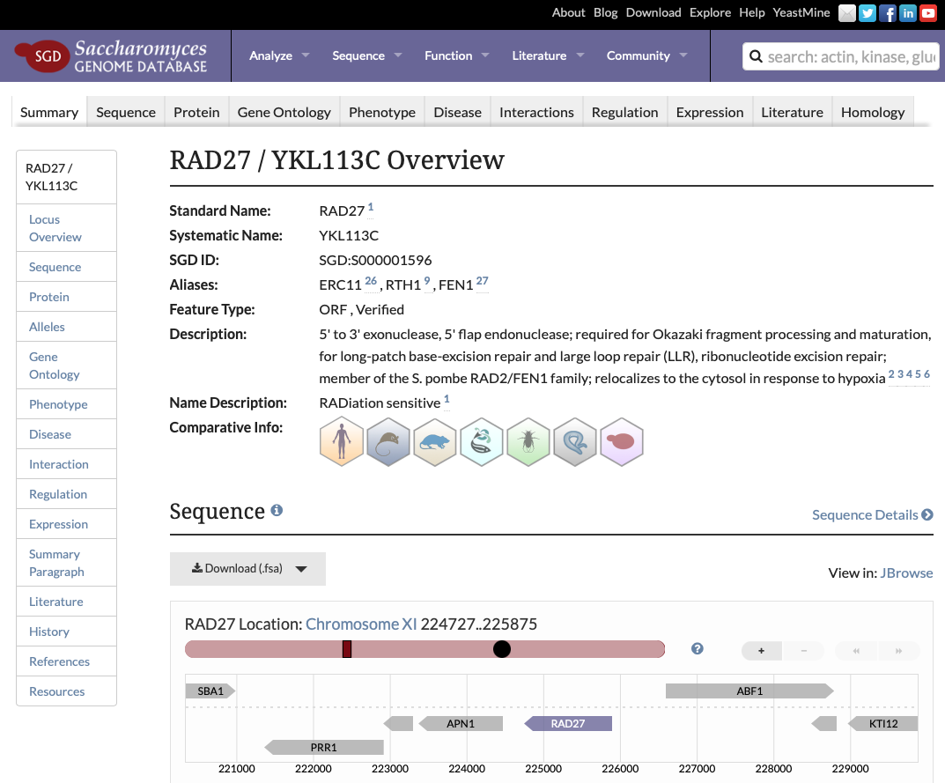
SGDID
local database identifier
in combo with source is ‘curie’
Most stable identifier
Nomenclature
Systematic Name
- generated by systematic sequencing project in 1990s
Standard Name
1st name published in peer-reviewed paper describing characterization
or, amalgam of
consensus of community
literature usage
clarity relative to function
priority in literature
Alias names
- alternate names used in literature
Least
stable
identifier
https://sites.google.com/view/yeastgenome-help/community-help/nomenclature-conventions

Slide 15
SGDID
local database identifier
in combo with source is ‘curie’
Nomenclature
Where to access data
YeastMine: ‘Retrieve SGD chromosomal Features’
Downloads: GFF
Systematic Name
- generated by systematic sequencing project in 1990s
Standard Name
1st name published in peer-reviewed paper describing characterization
or, amalgam of
consensus of community
literature usage
clarity relative to function
priority in literature
Alias names
- alternate names used in literature
https://sites.google.com/view/yeastgenome-help/community-help/nomenclature-conventions

Slide 16
Nomenclature
Verified ORF
experimental evidence that a protein is produced
have orthologs in Saccharomyces species
most named genes in this class
Uncharacterized ORF
likely to produce a protein
conserved among Saccharomyces species
no experimental evidence that product is made
Dubious ORF
unlikely to encode an expressed protein
not conserved among Saccharomyces species
no experimental evidence that product is made
Merged ORF
- no longer considered distinct entity
Deleted ORF
- officially withdrawn from annotation
Fisk et al. (2006) Saccharomyces cerevisiae S288C genome annotation: a working hypothesis. Yeast 23(12):857-65.

Slide 17
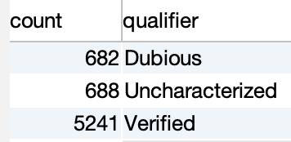
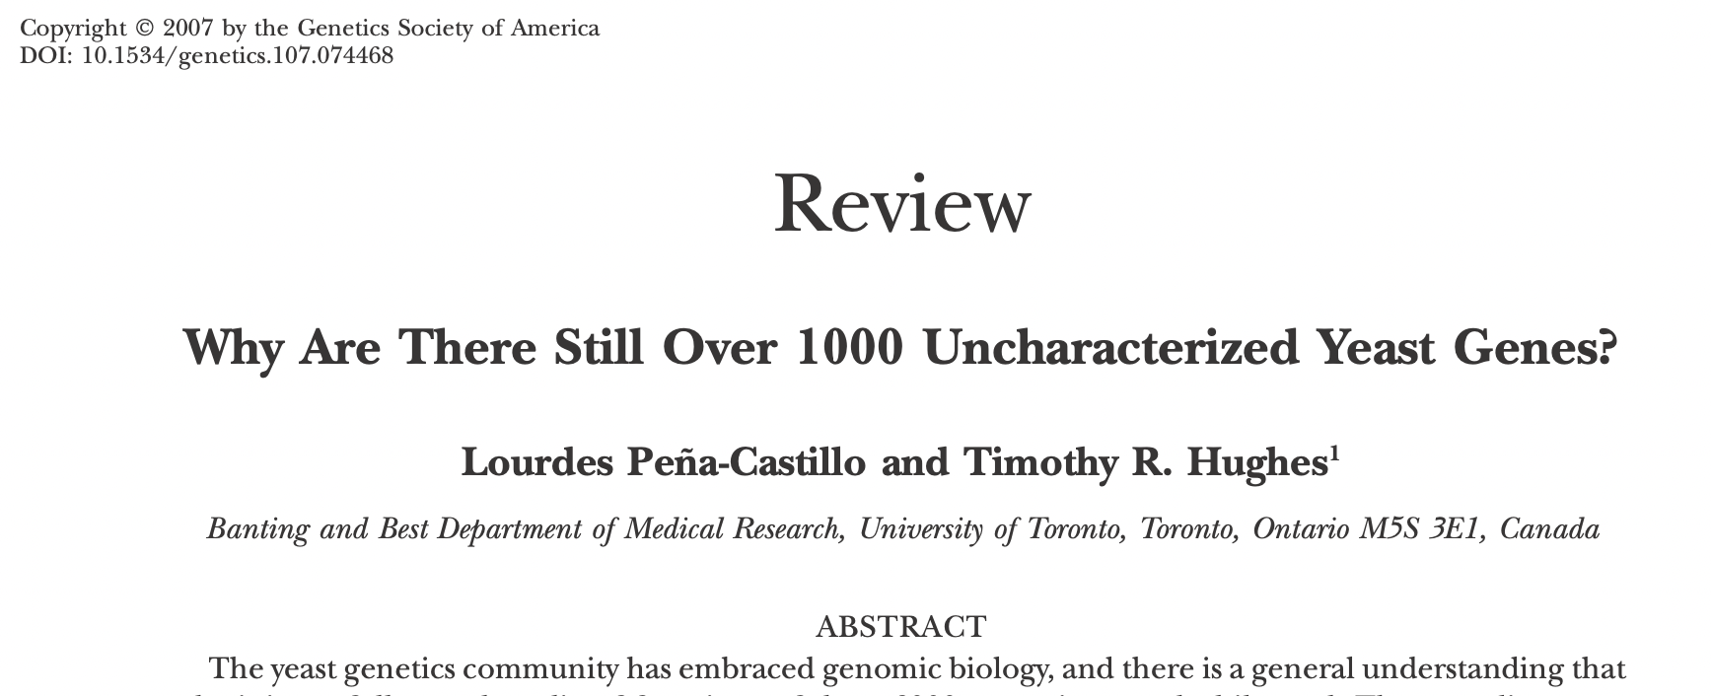
Nomenclature
Verified ORF
experimental evidence that a protein is produced
have orthologs in Saccharomyces species
most named genes in this class
Uncharacterized ORF
likely to produce a protein
conserved among Saccharomyces species
no experimental evidence that product is made
Dubious ORF
unlikely to encode an expressed protein
not conserved among Saccharomyces species
no experimental evidence that product is made
Merged ORF
- no longer considered distinct entity
Deleted ORF
- officially withdrawn from annotation
Fisk et al. (2006) Saccharomyces cerevisiae S288C genome annotation: a working hypothesis. Yeast 23(12):857-65.

Slide 18
SGD – basics, nomenclature, recent additions
Search & Explore
Genome version R64.3.1
New ncRNA systematic nomenclature
Updates to ‘legacy’ gene names
New ‘not in S288C’ systematic nomenclature
Updates to Reference Genome panel – in progress
Nomenclature conventions
Alleles and Allele pages
Updates to Interactions pages
New Homology pages
Disease pages
Extra bits - Supplementary data, published datasets, PubMed Central downloads
Submit Data
microPublication Biology
yeastgenome.org

Slide 19
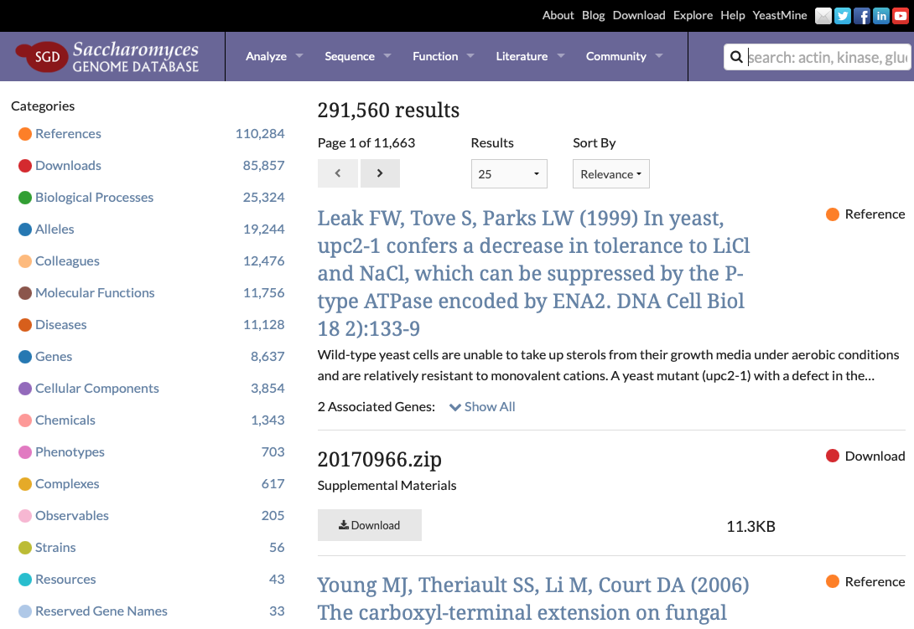
Alleles
Explore SGD
returns all objects in database
results updated daily
“Explore SGD” search result https://www.yeastgenome.org/search?q=&is_quick=true

Slide 20
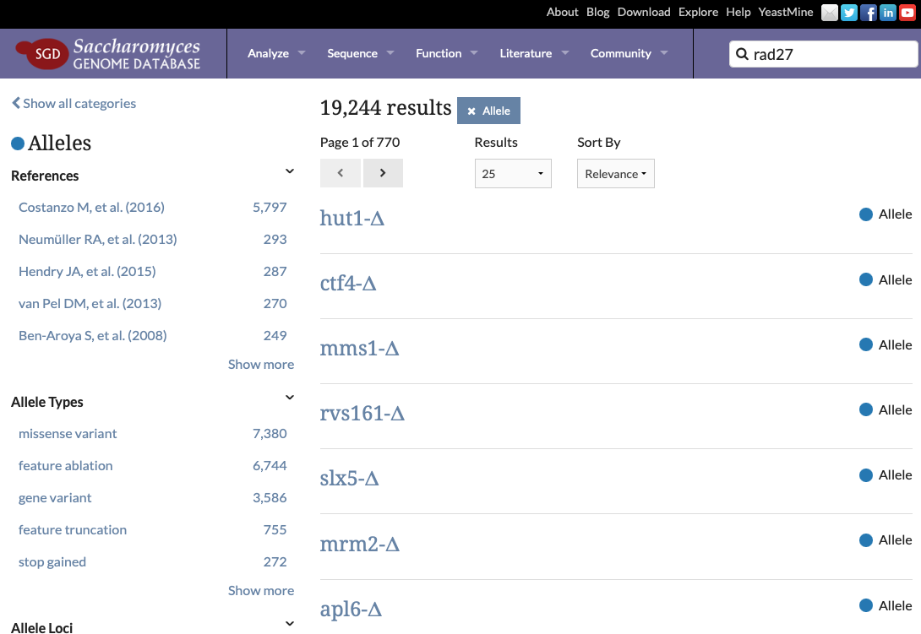
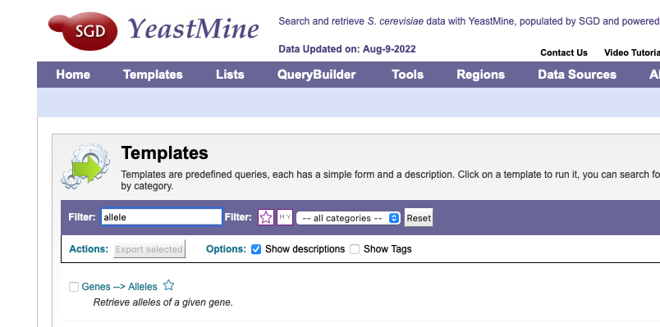
Alleles
Categories in Allele Search
Publication
Allele type – terms from Sequence Ontology
Gene
Phenotype
https://www.yeastgenome.org/search?q=&category=allele

Slide 21
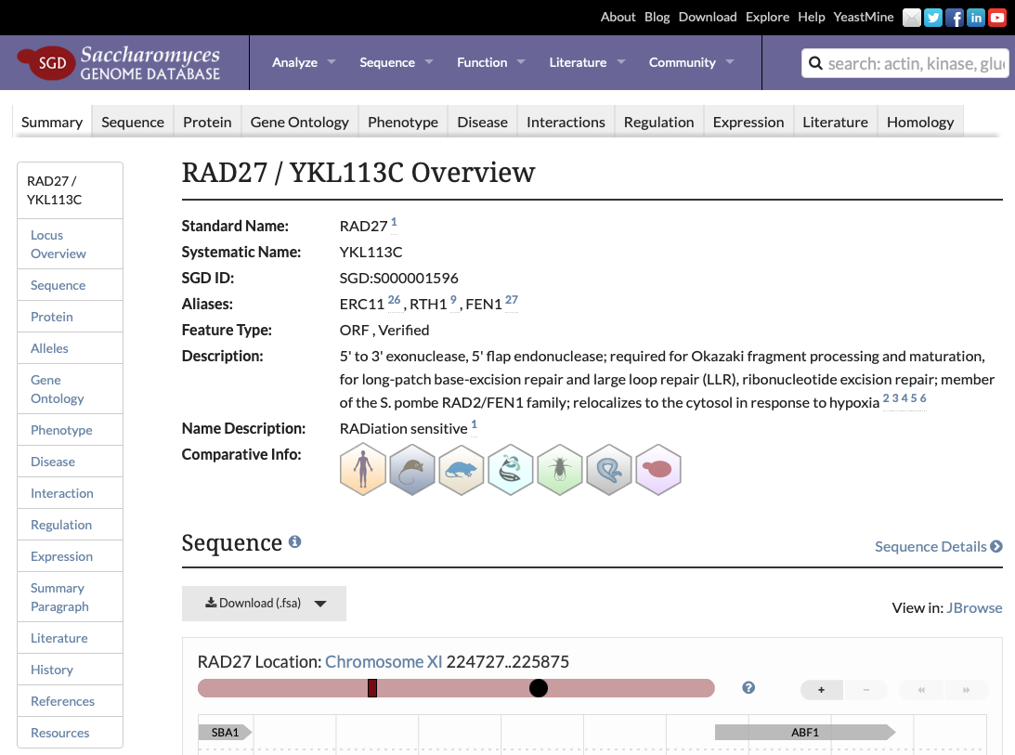
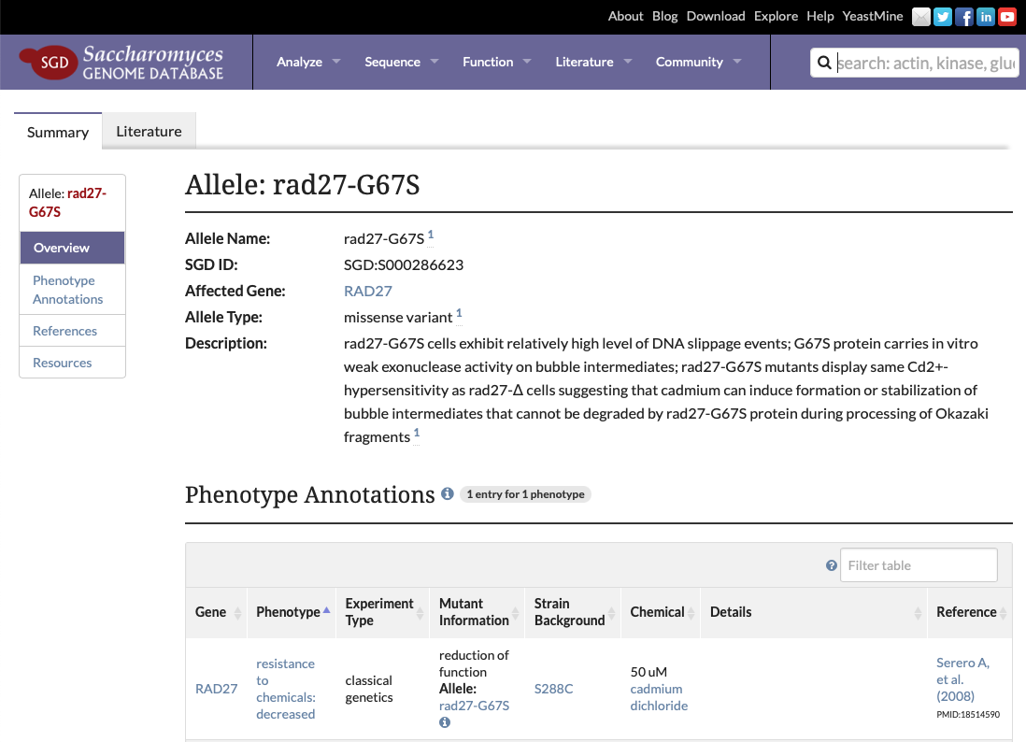
Alleles
https://www.yeastgenome.org/locus/RAD27

Slide 22
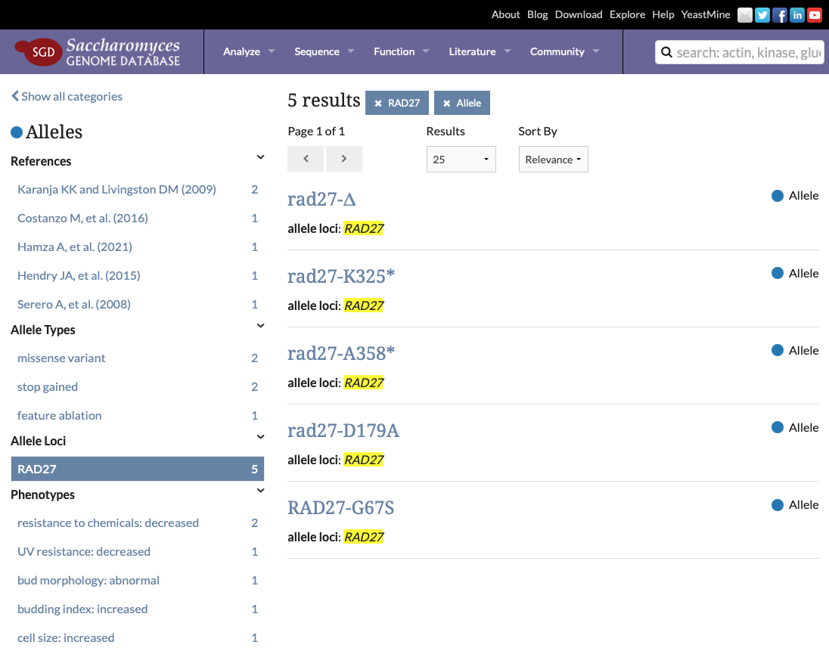
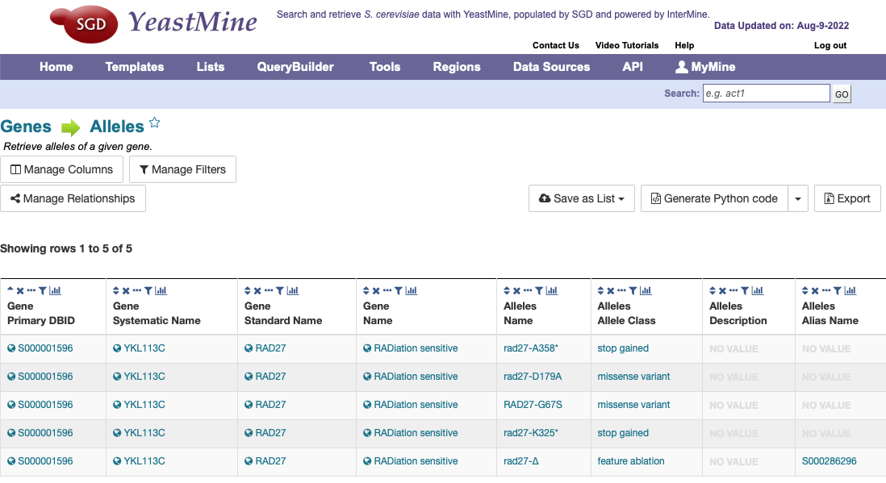
Alleles
https://www.yeastgenome.org/search?allele_loci=RAD27&category=allele

Slide 23
SGD – basics, nomenclature, recent additions
Search & Explore
Genome version R64.3.1
New ncRNA systematic nomenclature
Updates to ‘legacy’ gene names
New ‘not in S288C’ systematic nomenclature
Updates to Reference Genome panel – in progress
Nomenclature conventions
Alleles and Allele pages
Updates to Interactions pages
New Homology pages
Disease pages
Extra bits - Supplementary data, published datasets, PubMed Central downloads
Submit Data
microPublication Biology
yeastgenome.org

Slide 24
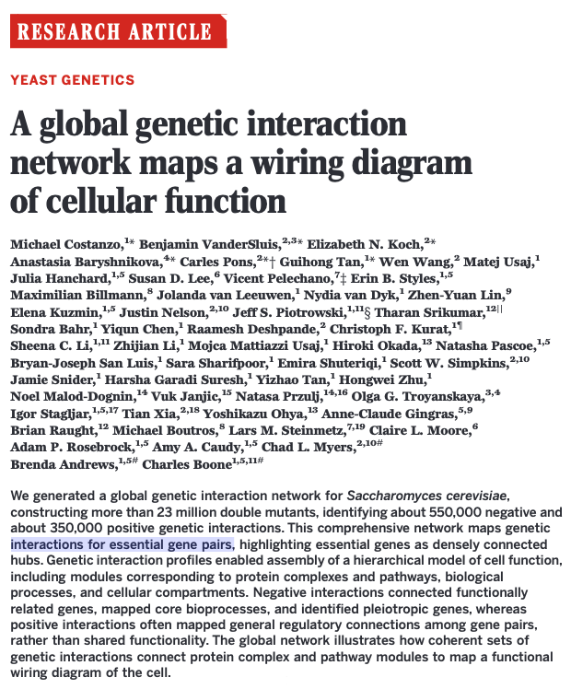
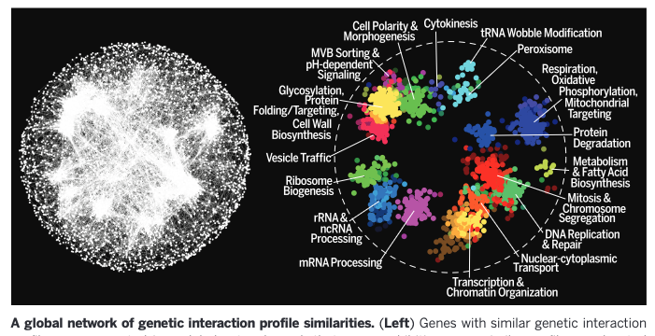
Interactions, Alleles

Slide 25
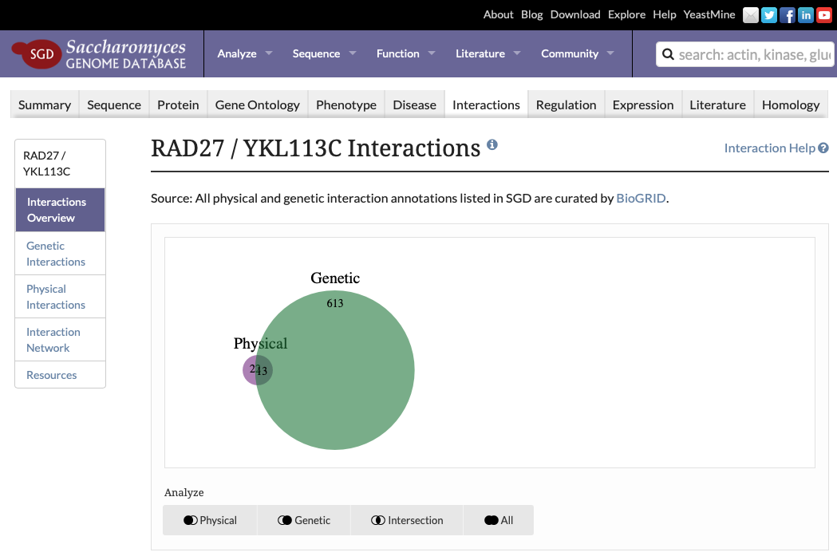
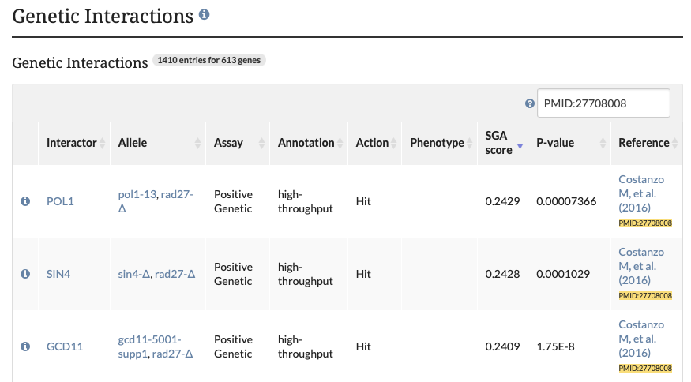
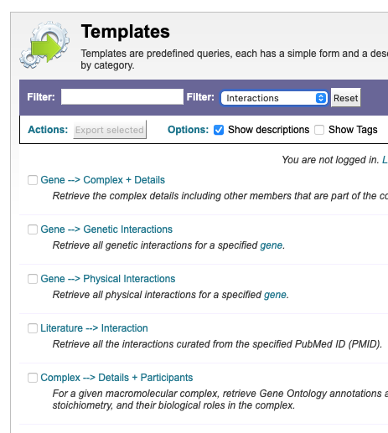
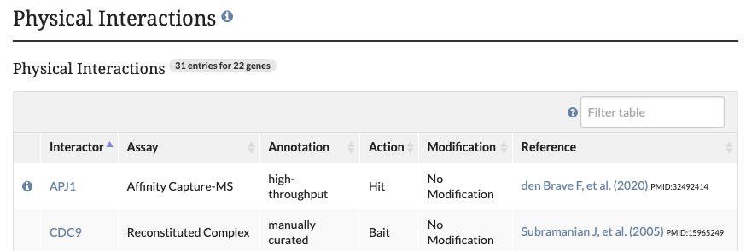
Interactions, Alleles
https://www.yeastgenome.org/locus/RAD27/interaction

Slide 26
SGD – basics, nomenclature, recent additions
Search & Explore
Genome version R64.3.1
New ncRNA systematic nomenclature
Updates to ‘legacy’ gene names
New ‘not in S288C’ systematic nomenclature
Updates to Reference Genome panel – in progress
Nomenclature conventions
Alleles and Allele pages
Updates to Interactions pages
New Homology pages
Disease pages
Extra bits - Supplementary data, published datasets, PubMed Central downloads
Submit Data
microPublication Biology
yeastgenome.org

Slide 27
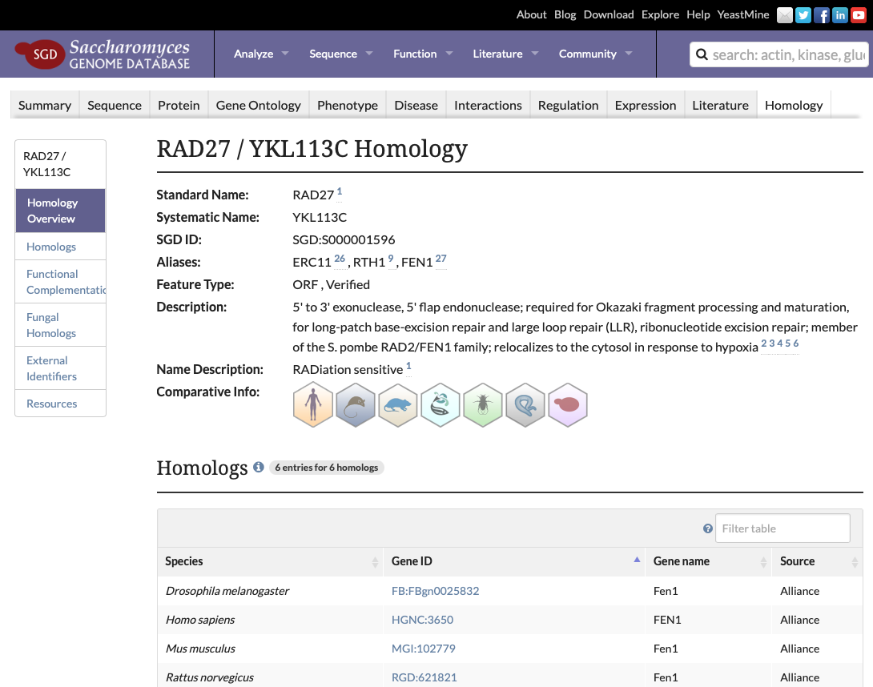
Homology
Early work product from Alliance: consolidated set of orthologs
Source: DIOPT via Alliance API
Icons linkout to Alliance gene pages
https://www.flyrnai.org/cgi-bin/DRSC_orthologs.pl

Slide 28
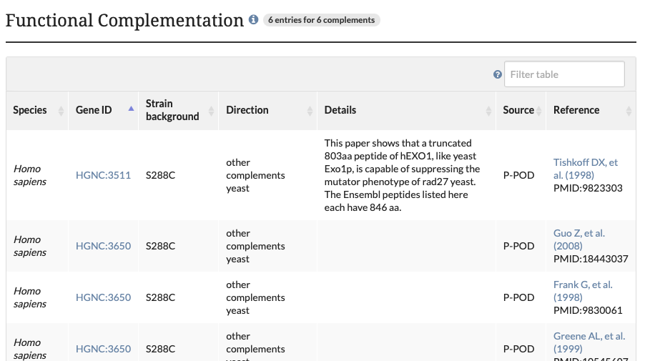
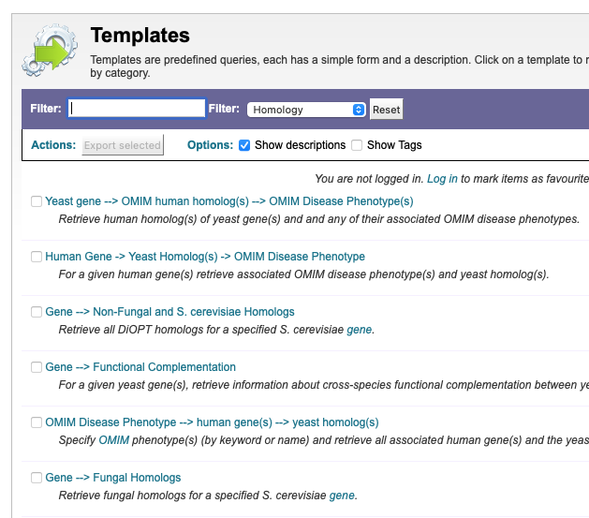
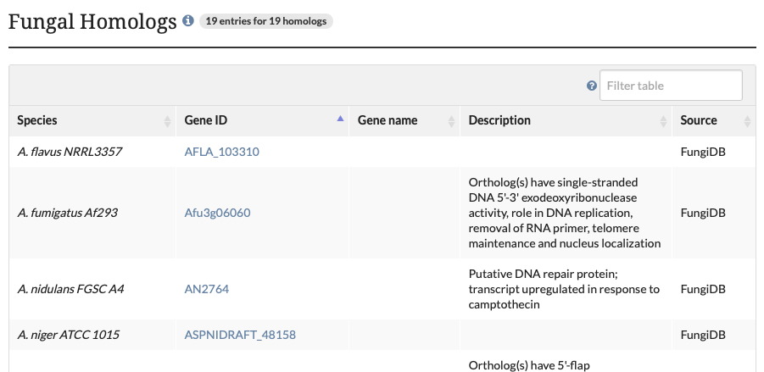
Homology
https://www.yeastgenome.org/locus/rad27/homology

Slide 29
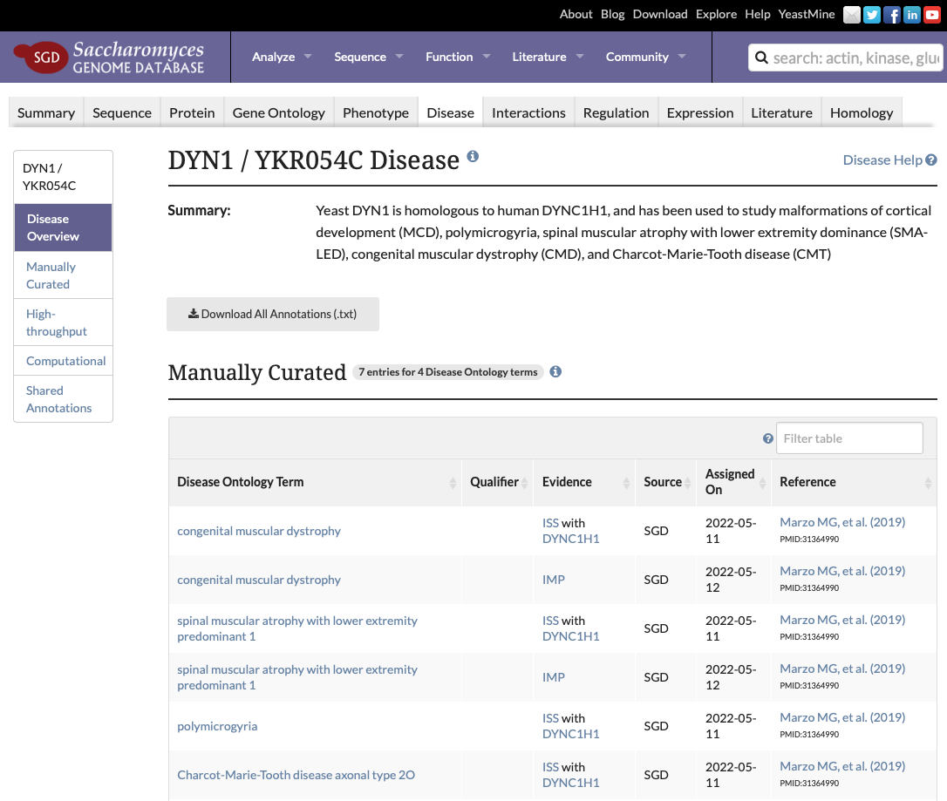
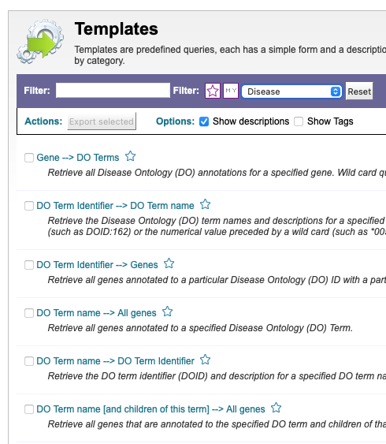
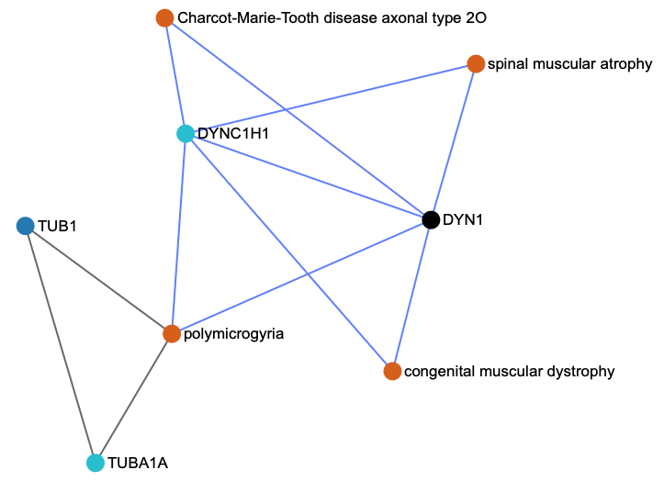
Disease
https://disease-ontology.org https://www.yeastgenome.org/locus/dyn1/disease

Slide 30
SGD – basics, nomenclature, recent additions
Search & Explore
Genome version R64.3.1
New ncRNA systematic nomenclature
Updates to ‘legacy’ gene names
New ‘not in S288C’ systematic nomenclature
Updates to Reference Genome panel – in progress
Nomenclature conventions
Alleles and Allele pages
Updates to Interactions pages
New Homology pages
Disease pages
Extra bits - Supplementary data, published datasets, PubMed Central downloads
Submit Data
microPublication Biology
yeastgenome.org

Slide 31
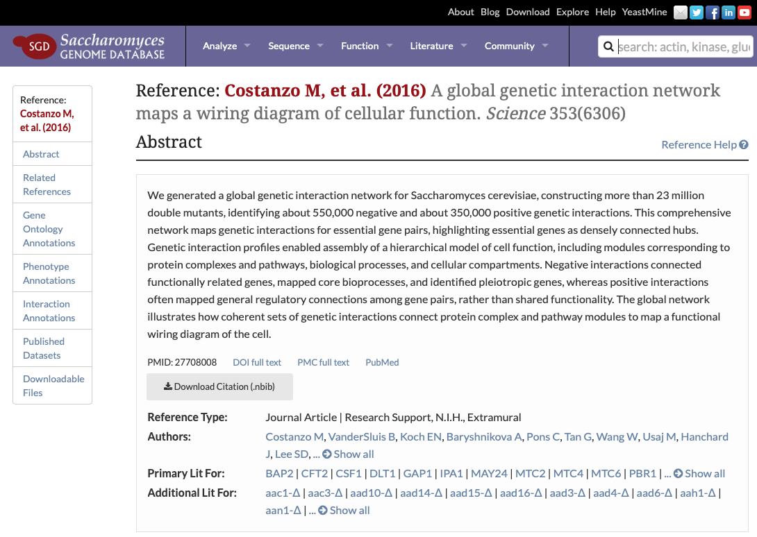
Extra bits
https://www.yeastgenome.org/reference/27708008

Slide 32
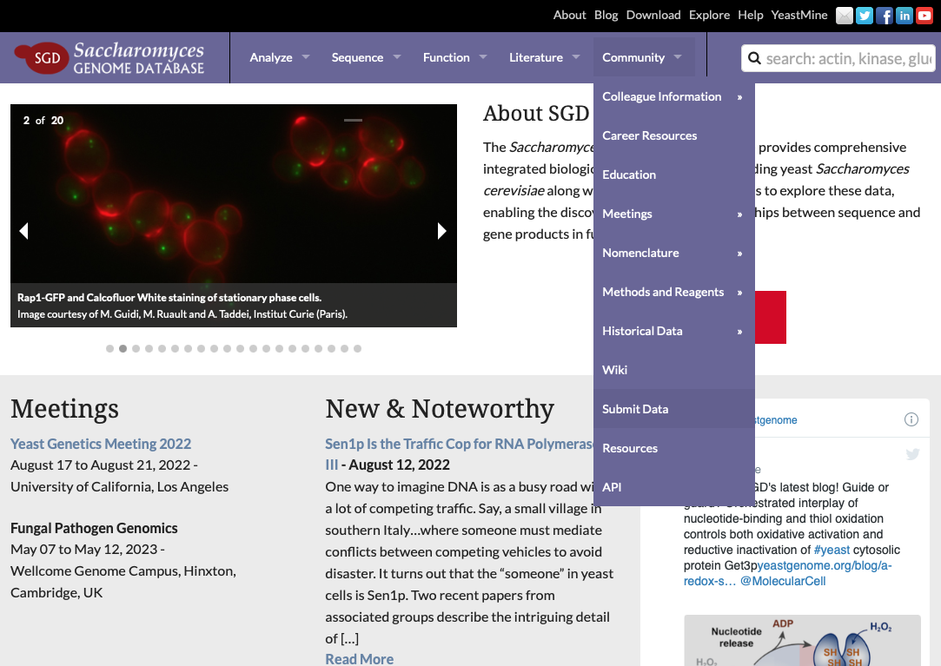
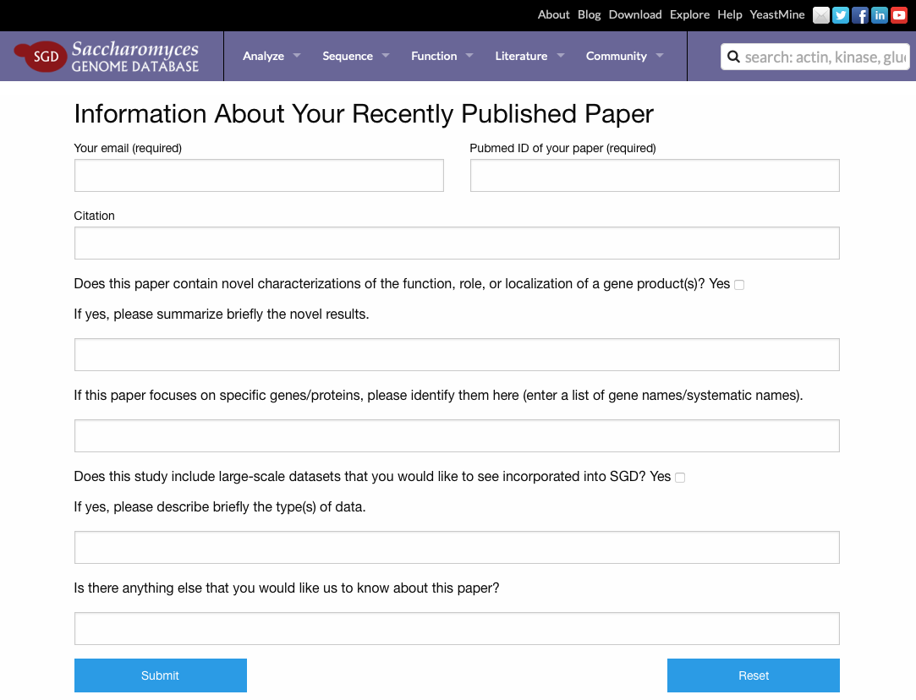
Submit Data
https://www.yeastgenome.org/submitData

Slide 33
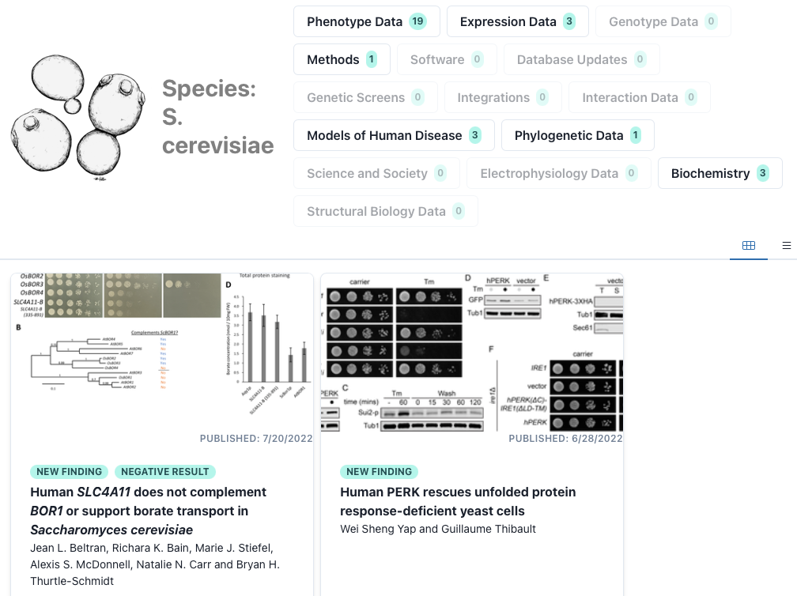
microPublication Biology
https://www.micropublication.org

Slide 34
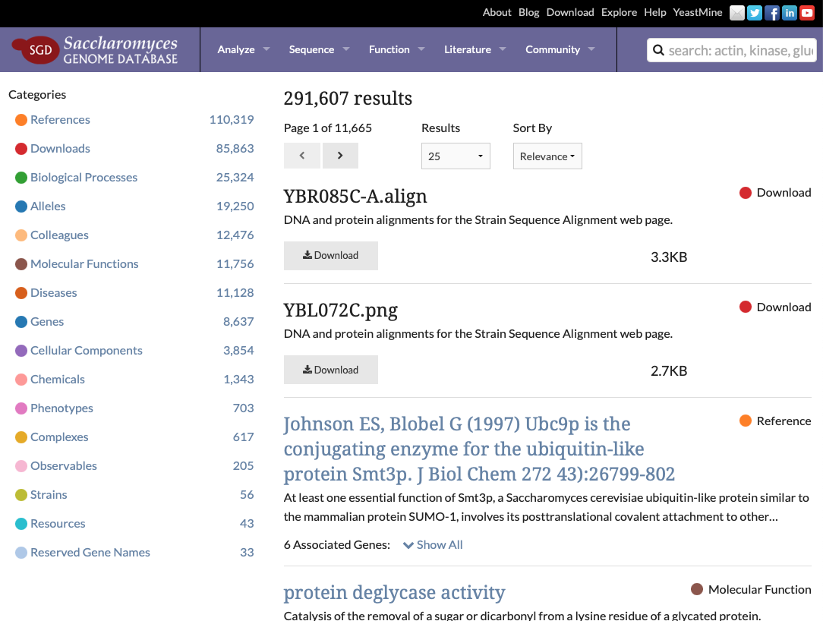
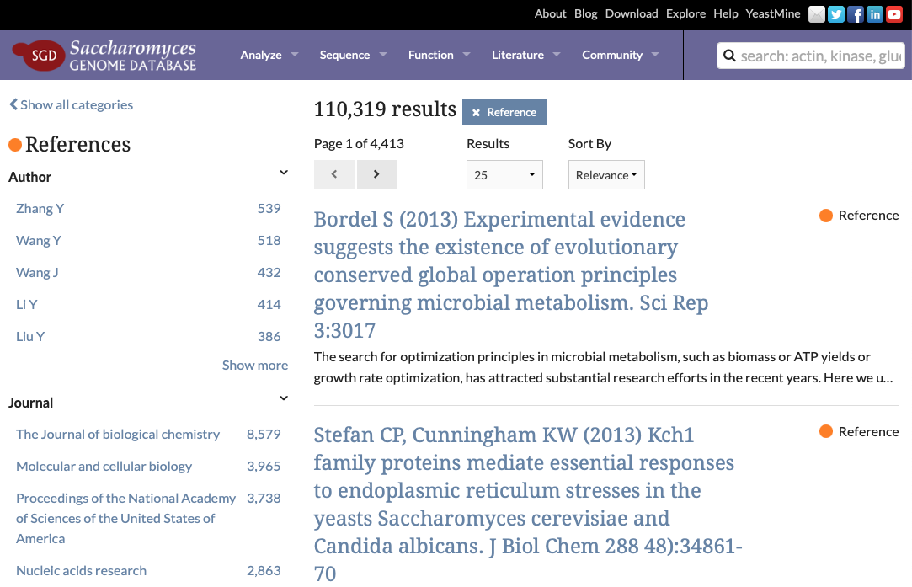
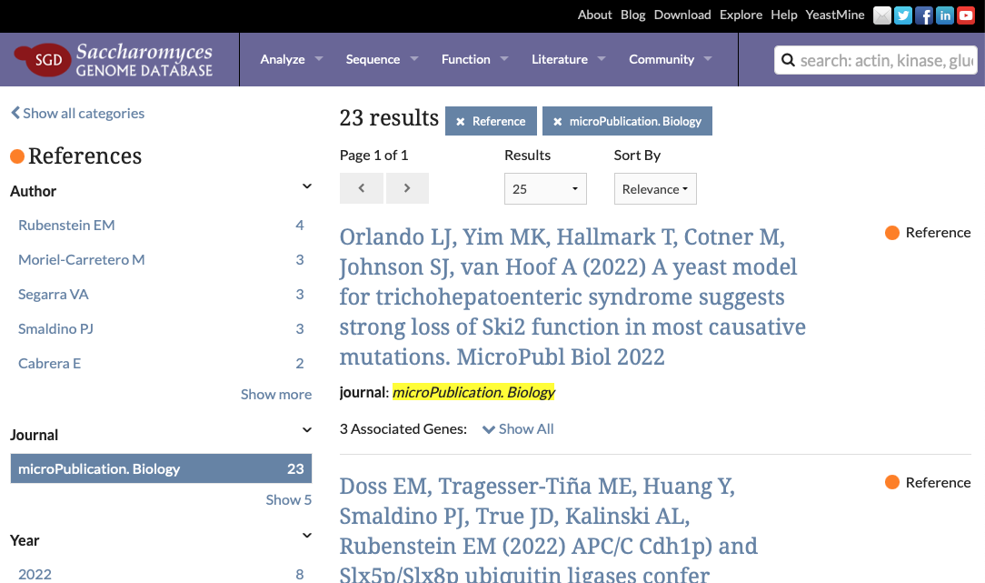
microPublication Biology
https://www.yeastgenome.org/search?category=reference&journal=microPublication.%20Biology&page=0&q=

Slide 35
Leadership
Team
Mike Cherry, PhD
Stacia Engel, PhD
Biocuration Team
yeastgenome.org
alliancegenome.org
geneontology.org
yeastmine.yeastgenome.org
Rob Nash, PhD
Edith Wong, PhD
Marek Skrzypek, PhD
Suzi Aleksander
Rahi Nevalkar, MS
Jodi Lew-Smith, PhD
Software Team
Shuai Weng, PhD
Kalpana Karra, MS
Stuart Miyasato

Slide 36
SGD homepage https://www.yeastgenome.org
SGD staff https://cherrylab.stanford.edu/people/sgd-staff
“Explore SGD” search result https://www.yeastgenome.org/search?q=&is_quick=true
Latest SGD publication https://www.yeastgenome.org/reference/34897464/
“Not in S288C” genes https://www.yeastgenome.org/search?q=ysc0&category=locus
R64.3.1 details: https://wiki.yeastgenome.org/index.php/Details_of_2021_Reference_Genome_Annotation_Update_R64.3
Download strain sequences, annotation http://sgd-archive.yeastgenome.org/sequence/strains/
Nomenclature guide https://sites.google.com/view/yeastgenome-help/community-help/nomenclature-conventions
SGD glossary https://sites.google.com/view/yeastgenome-help/sgd-general-help/glossary
YeastMine - Retrieve SGD chromosomal Features
https://yeastmine.yeastgenome.org/yeastmine/template.do?name=SGD_Chr_Features_Tab&scope=all
GFF file http://sgd-archive.yeastgenome.org/curation/chromosomal_feature/saccharomyces_cerevisiae.gff.gz
Glossary https://sites.google.com/view/yeastgenome-help/sgd-general-help/glossary
SGD Publication re ORF qualifiers https://www.yeastgenome.org/reference/17001629
“All allele” search result https://www.yeastgenome.org/search?q=&category=allele
DIOPT Ortholog Prediction https://www.flyrnai.org/cgi-bin/DRSC_orthologs.pl
Homology page https://www.yeastgenome.org/locus/rad27/homology
Disease page https://www.yeastgenome.org/locus/dyn1/disease
SGD reference page Costanzo et al. 2016 https://www.yeastgenome.org/reference/27708008
microPublication Biology https://www.micropublication.org

