Slide 1
The power of SGD
http://www.yeastgenome.org
Notes:
Tell you about the data and tools that we provide
How many people study S. cerevisiae? (and that doesn’t include drinking beer, wine, or eating bread)
How many people have heard of SGD?
How many people use SGD?

Slide 2
SGD overview
Notes:
Community resource for comprehensive, integrated biological information for S. cerevisiae
As a community resource, we provide: Community information – meetings, researcher contact information, wiki for protocols and job listings
All new features in Blog; periodic newsletters, you can subscribe
We also provide the reference genome sequence for S. cerevisiae as well as encyclopedic information about the genome, genes, proteins, and other encoded features
Genomic sequence
High-quality, manually curated information about encoded features
High-throughput data
Homologs
Search and analysis tools
Transition: So, you’re probably asking yourself, “All this information sounds fantastic! How can I access it?”

Slide 3
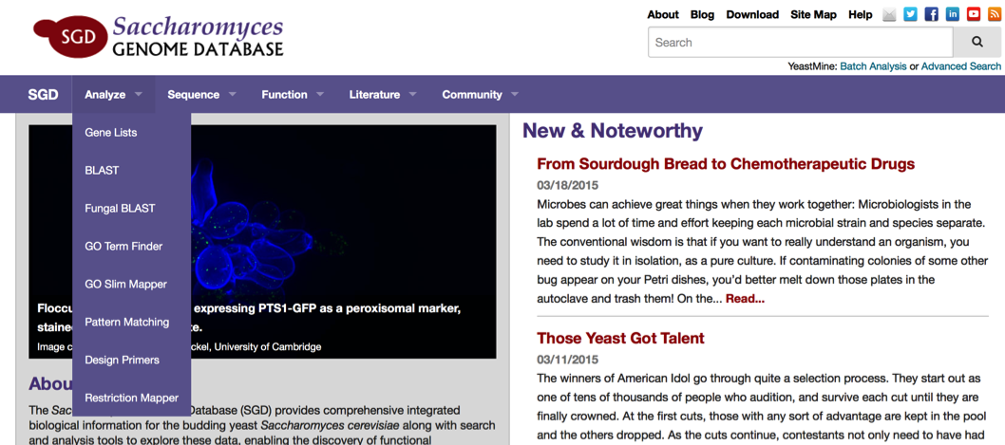
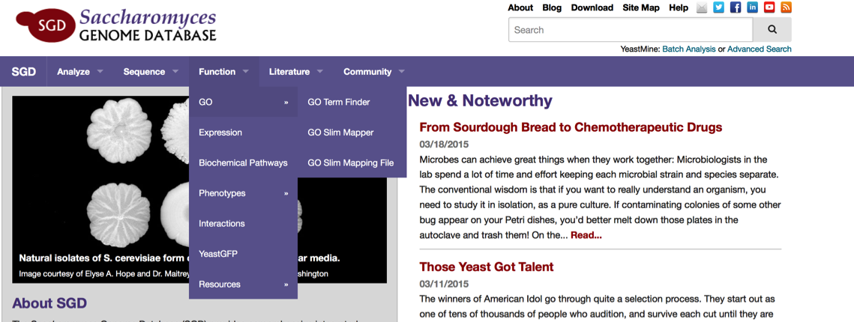
Accessing data
Notes:
There are a few ways to get to our wealth of information.
If you have a S. cerevisiae gene name, you could enter in the search box to get to a page with all of our curated information about that locus. From there, if you’re interested in homologs, you could analyze the sequence or use the resources on the Sequence page. We’ll talk about that in a little bit.
Or, if you are interested in downloading all the annotations of a specific data type, you can click on this ‘Download’ link, or use the pulldowns.
If you coming into SGD with the name or sequence of a gene or protein from a different organism, such as Candida glabrata, you can also use that to find information about the homolog in S. cerevisiae. Using the ‘Sequence’ pull-down in the header, you can go to Fungal BLAST.
Quickly, if you are interested in doing your own analysis, you can download a lot of information (sequence, some HTP data, annotations) using our downloads site (show)
There are a number of other ways, using these pulldowns and links to get to this information as well.

Slide 4
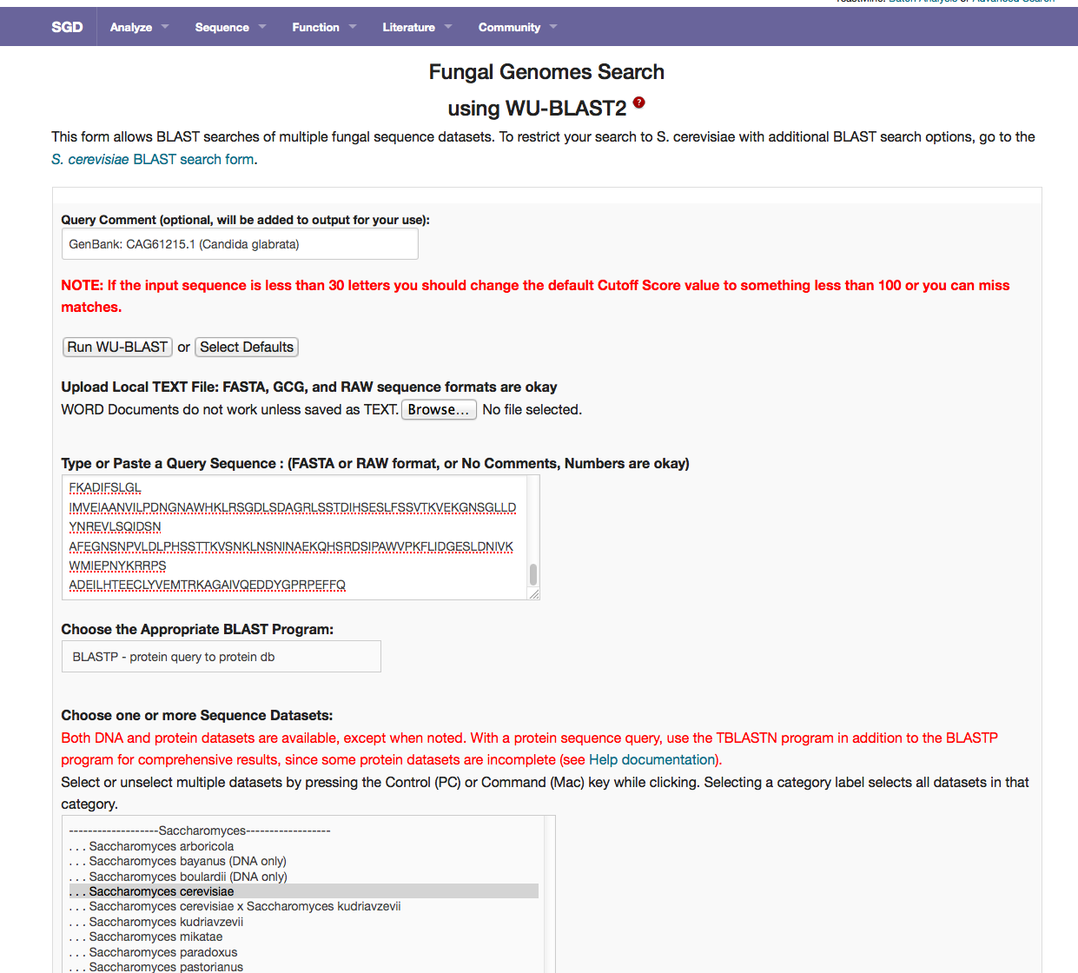
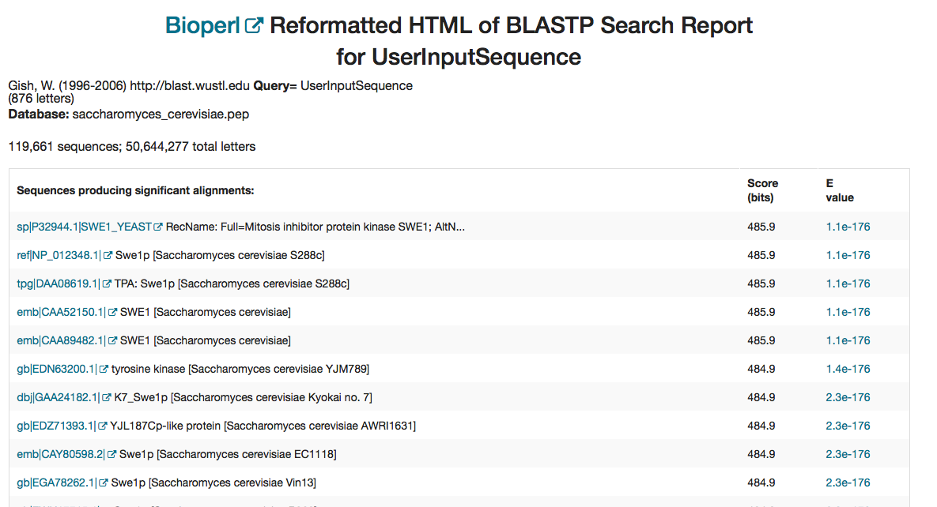
Finding S. cerevisiae homologs
Notes:
Here’s an example of using Fungal Blast with a Candida glabrata sequence that I retrieved from NCBI.
You can see I just selected ‘Saccharomyces cerevisiae’, but there are a lot more genomes that you can BLAST against.
In the results, you can see that SWE1 is the best hit. Clicking on a link will take you to NCBI, but you can use this gene name in the search box that is in the header of every page to get to the gene information about SWE1.
**Transition – So, let’s go back to the Fungal BLAST page – remember there are a lot more fungal genomes that you can use to BLAST against. In fact, there are almost 300 fungal genome sequences.

Slide 5
Fungal genomes to BLAST
Saccharomyces
Candida
Saccharomycetaceae Other Saccharomycetales (budding yeasts; ex: Pichia, Yarowia)
Schizosaccharomyces (Fission yeasts)
Dothideomycetes (Plant fungi)
Chaetothyriales (black yeasts)
Aspergillus
Penicillium
Green and blue molds (other Eurotiales)
Arthrodermatacieae (dermatophytes)
Other Onygenales (Coccidioides and related)
Leotiomycetes (non-lichenized fungi)
Glomerellales (endophytic fungi)
Fusarium and related (Hypocreales)
Sordariales (Neurospora and related)
Other Sordariomycetidae (unitunicate perithecial fungi)
Other Ascomycota
Agaricomycetes (gill mushrooms and related)
Tremellales (jelly fungi)
Ustilaginomycotina (true smut fungi)
Other Basidiomycota
Microsporidia
Other Fungi
Notes:
I’ve broken the list down into the major fungal families.
So, you can see that there are a number of genomes that you can BLAST against
**Transition: Let’s go back to the example with the C. glabrata example --
Major fungal families:
Saccharomyces
Candida
Saccharomycetaceae
Other budding yeasts
Fission yeasts (Schizosaccharomyces)
Plant fungi (Dothideomycetes)
Chaetothyriales (black yeasts)
Aspergillus
Penicillium
Green and blue molds (other Eurotiales)
Arthrodermatacieae (dermatophytes)
Other Onygenales (Coccidioides and related)
Leotiomycetes (non-lichenized fungi)
Glomerellales (endophytic fungi)
Fusarium and related (Hypocreales)
Sordariales (Neurospora and related)
Other Sordariomycetidae (unitunicate perithecial fungi)
Other Ascomycota
Agaricomycetes (gill mushrooms and related)
Tremellales (jelly fungi)
Ustilaginomycotina (true smut fungi)
Other Basidiomycota
Microsporidia
Other Fungi

Slide 6
Finding S. cerevisiae homolog data
Notes:
Remember, for the results, if you click on the link, it takes you to NCBI. To get to the information in SGD, you can put the gene name into the search box and press enter

Slide 7
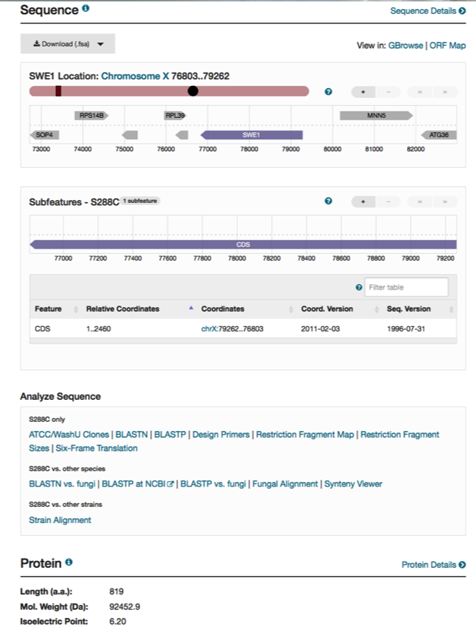
High-quality, manually curated information
Notes:
You’ll get taken to the Locus Summary page for SWE1. Here, you can find summaries of all the different types of data that we curate.
At the top of the page, you can see an overview of the gene – name, systematic name, type of feature it is, and description of the protein function. Along the left-hand side of the page, you can see the different data types that we’ve curated, in separate sections.
In section is a summary of the curated data type, and you can click on the details link for more detailed information. Also, along the top of the page, there are tabs that correspond to each section which will also take you to that specific data page.
We have sequence and protein information.

Slide 8
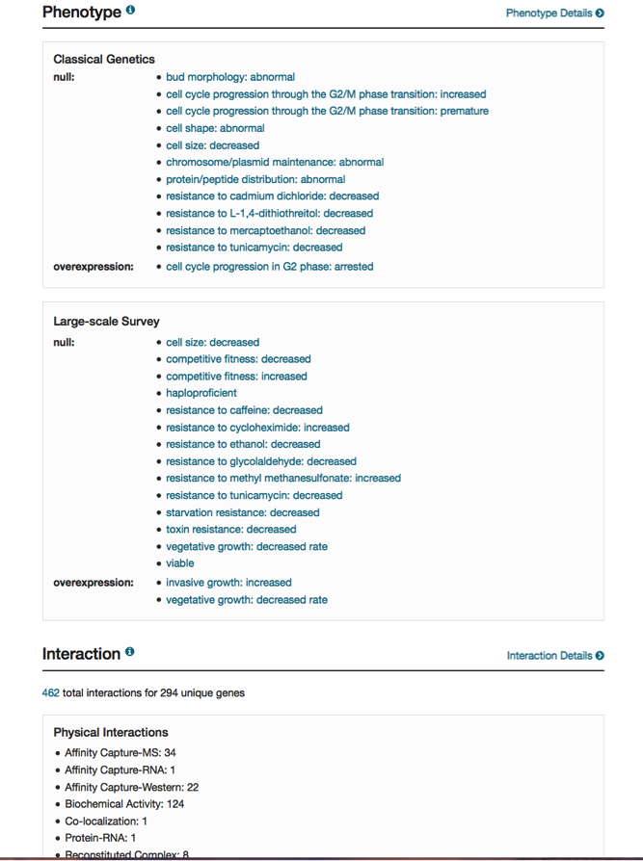
High-quality, manually curated information
Notes:
functional information that we have curated with gene ontology annotations, phenotype and protein interaction data.

Slide 9
High-quality, manually curated information
Notes:
Further down the page, we have microarray expression data and many genes have summary paragraphs – which a curator wrote after reviewing relevant literature.
So, starting with some sequence from C. glabrata, we’ve found out some information about the S. cerevisiae homolog, SWE1. We can explore its expression, and functional annotations on this page. If we wanted to see how the sequence of SWE1 differs between different cerevisiae strains, we’d click on the ‘details’ link or the ‘Sequence’ tab
As I mentioned, we provide the reference genome for S. cerevisiae. However, there are many other strains of S. cerevisiae which have been sequenced, and we now provide information about those as well.
** Transition **: Remember these links to more information about a data type. If I now want to find out more about the sequence of SWE1, I’d click on this ‘Sequence Information’ or ‘sequence’ tab at the top of the page, and end up here (click to next slide)

Slide 10
Reference strains sequence
Notes:
Here again, you can see an overview of the general locus information.
And also sequence – genomic and protein;
Now we provide alternative reference sequences. As you can see, we provide about 10 different alternative reference strain sequences. We are also actively working on a viewer to compare the sequences of these features between the different reference strain sequences. If there’s time, I can show you a screenshot of what we’ve developed so far.

Slide 11
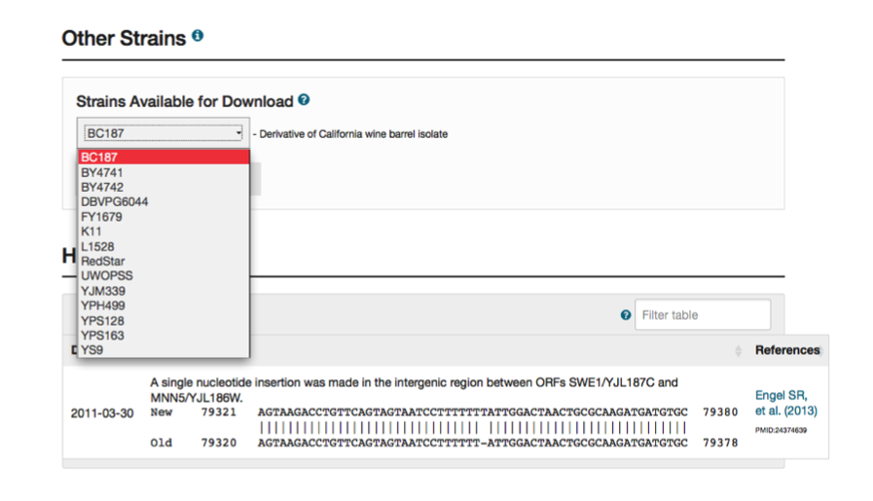
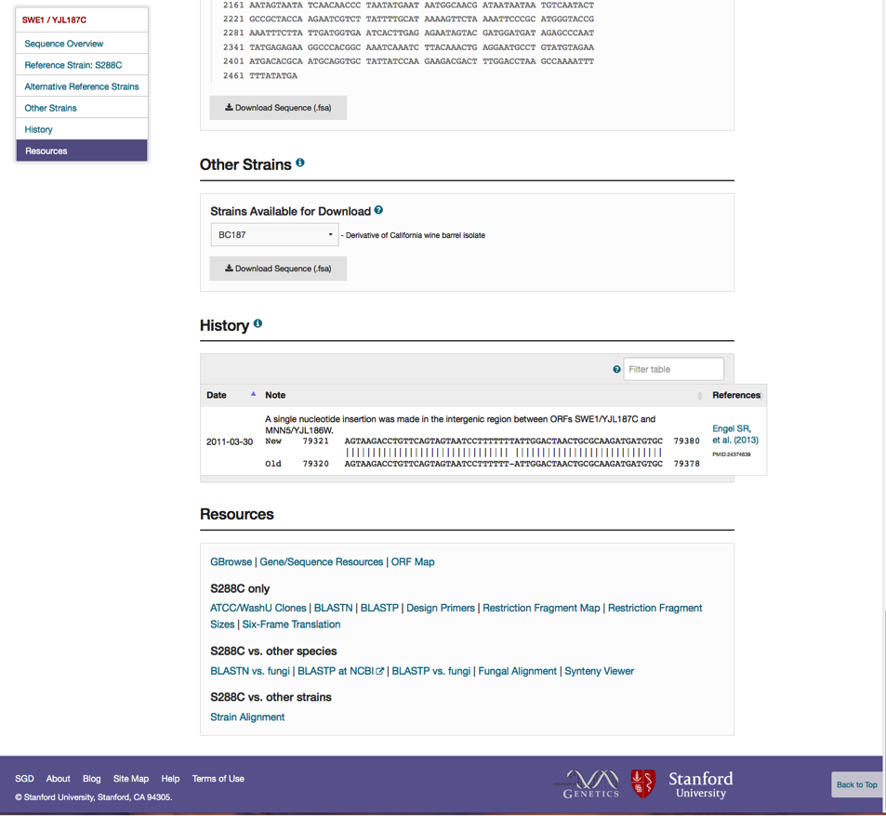
Additional strains sequences
Notes:
We are also providing additional reference sequences for download (mostly non-lab strains).
And, using the links in this Resources section, you can find homologs to SWE1 in other fungal species, or other strains
**Transition**: So, I just showed you how to use sequence from another organism to get to information about the S. cerevisiae homolog. But what if you have a specific gene or list of genes in another organism that you’d like to find homologs for? Well, I’ll show you

Slide 12
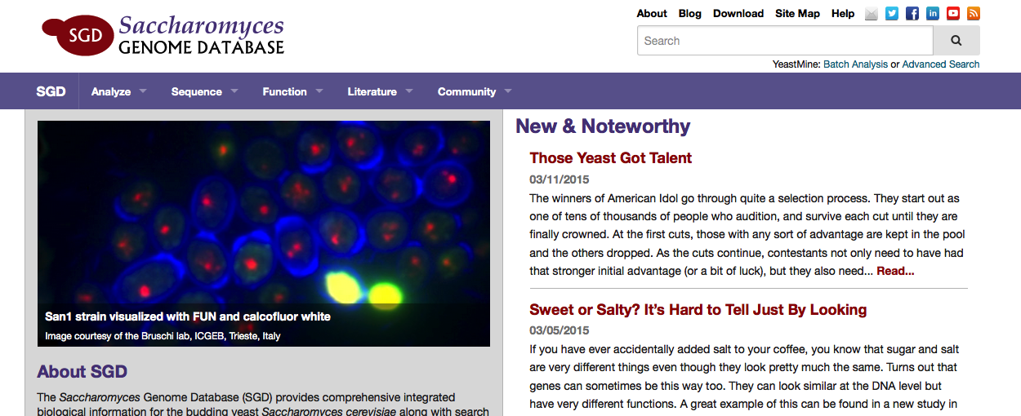
Advanced searches
Notes:
Multiple ways to search SGD
Already, I told you how you can use sequences from other fungal organisms to find S. cerevisiae homologs and data
Talked about using S. cerevisiae sequence or gene information to do the reciprocal search for other fungal homologs
Searching – fungal alignment with S. cerevisiae gene; search box for name, GO term, publication
Yeastmine – An instance of InterMine, a warehouse of S. cerevisiae biological data; powerful search tool
Let’s click on ‘Batch Analysis’ or ‘Advanced Search’ for example.

Slide 13
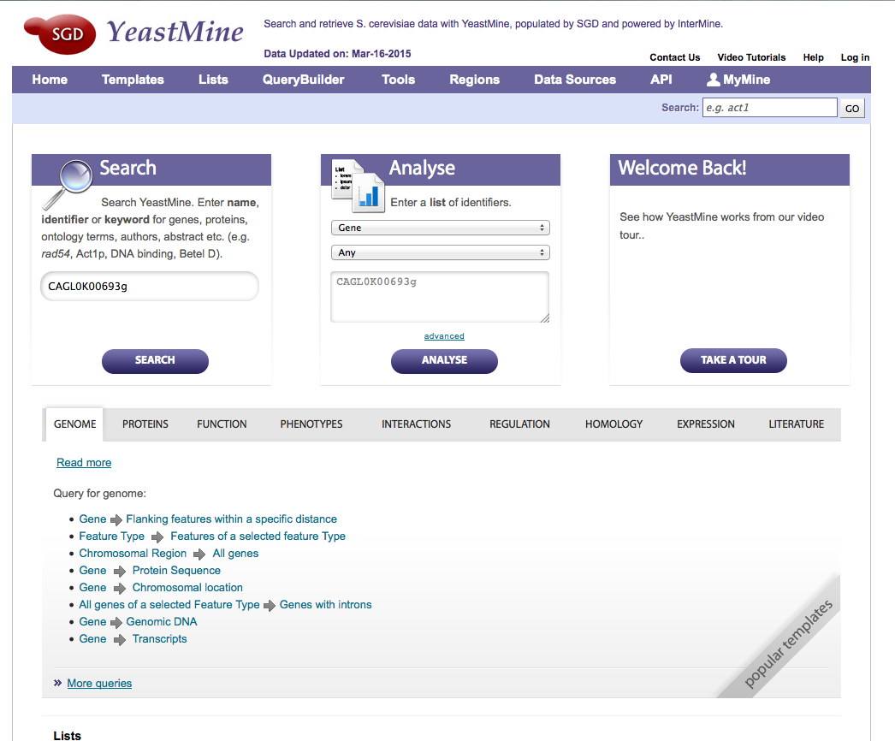
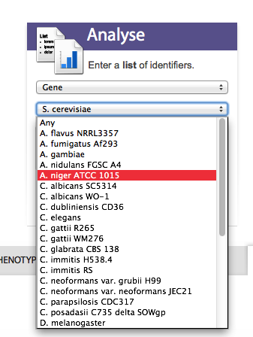
YeastMine
Notes:
YeastMine is a yeast-specific instance of InterMine, a data warehouse that has a powerful search tool
Which allows us to search all SGD data using a specific gene name or Identifier – even non-S. cerevisiae; a short list of gene names
Since InterMine is used by multiple model organism databases, you can even search non-S. cerevisiae organisms
There are some pre-created query forms, including homologs.
If you put in a gene name from another organism, such as this from C. glabrata, you’ll get a page of general information about the gene, as well as links to the appropriate model organism database or NCBI page.
**Trans** Alternatively, if you have the cerevisiae gene name, you can use these pre-generated query forms to find homologs in other organisms.

Slide 14
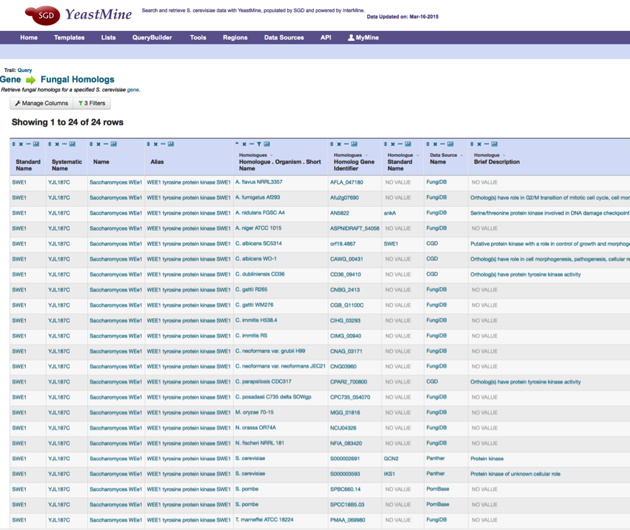
S. cerevisiae to fungal homolog
YeastMine tutorials:
http://bit.ly/sgd-youtube
Notes:
You could search with one gene or a list of genes – either pregenerated, or a list that you’ve created
Either way, you will have a list of homologs in different fungal species
That barely scratched the surface of what YeastMine can do, and I’d be happy to answer any questions about it later, and we have a number of useful short, tutorial videos on YouTube.

Slide 15
Coming attraction
Notes:
Look at variation between S288C and alternative references sequences;
If you click on a lollipop, you can see the sequence differences between the reference strains
You can look at genomic and protein sequences
This should be in production in the next couple of months.

Slide 16
Want more information?
Contact us:
http://www.yeastgenome.org/suggestion
sgd-helpdesk@lists.stanford.edu
Subscribe to SGD’s YouTube channel: http://bit.ly/sgd-youtube
Follow us on Twitter: @yeastgenome
Find us on Facebook and LinkedIn: Saccharomyces Genome Database
Notes:
Or, above every search box in every header on most of our pages, just click on the appropriate icon to e-mail SGD curators or follow SGD using social media.

