Slide 1
Gene Ontology at SGD: GOSlimMapper
ICYGMB 2019
Suzi Aleksander

Slide 2
Gene Ontology overview
GO:0006366 transcription by RNA polymerase II

Slide 3
Gene Ontology overview
GO:0006366 transcription by RNA polymerase II
GO:0072367 regulation of lipid transport by regulation of transcription from RNA polymerase II promoter

Slide 4
Gene Ontology overview
GO:0006366 transcription by RNA polymerase II
GO:0072367 regulation of lipid transport by regulation of transcription from RNA polymerase II promoter
GO:0035968 regulation of sterol import by regulation of transcription from RNA polymerase II promoter

Slide 5
Gene Ontology overview
GO:0006366 transcription by RNA polymerase II
GO:0072367 regulation of lipid transport by regulation of transcription from RNA polymerase II promoter
GO:0035968 regulation of sterol import by regulation of transcription from RNA polymerase II promoter

Slide 6
Gene Ontology overview
GO:0006366 transcription by RNA polymerase II
GO:0072367 regulation of lipid transport by regulation of transcription from RNA polymerase II promoter
GO:0035968 regulation of sterol import by regulation of transcription from RNA polymerase II promoter
GO:0006369 termination of RNA polymerase II transcription

Slide 7
Gene Ontology overview
Notes:
Describes biological function of gene products
Terms are computer- & human-readable
Defined relations between terms

Slide 8
Gene Ontology overview
Notes:
Describes biological function of gene products
Terms are computer- & human-readable
Defined relations between terms

Slide 9
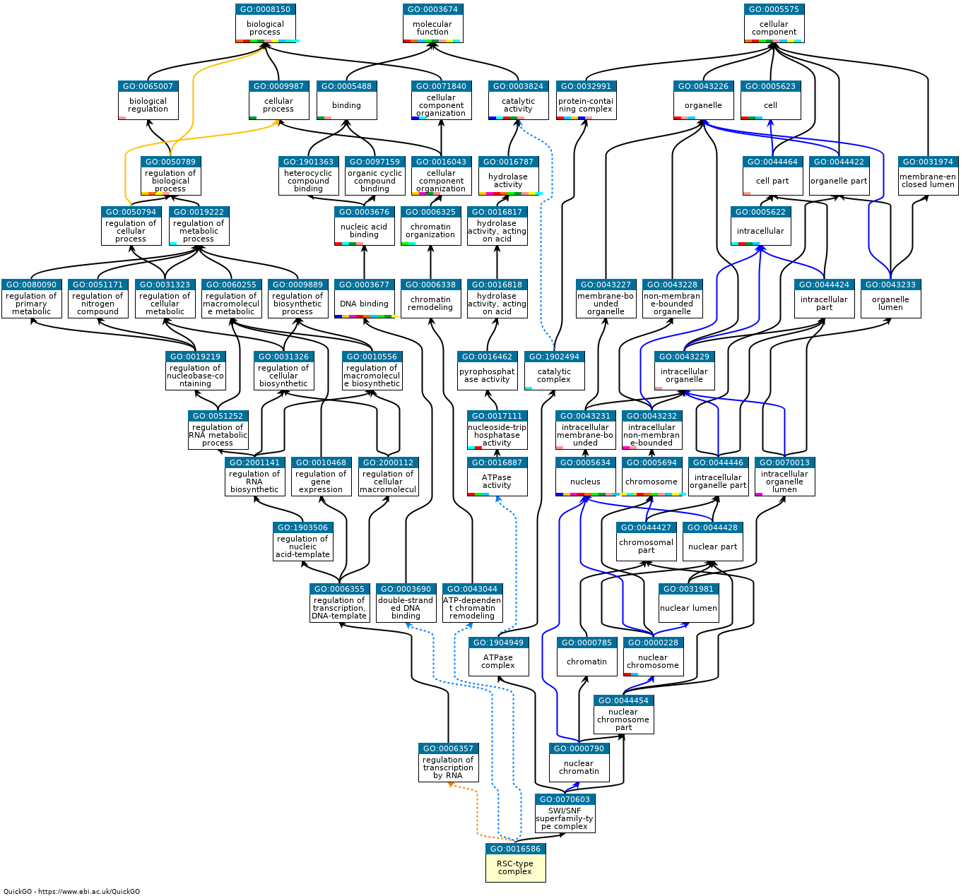
Gene Ontology overview
Notes:
Describes biological function of gene products
Terms are computer- & human-readable
Defined relations between terms

Slide 10
GO Slim Mapper yeastgenome.org/goSlimMapper
GO:0006366 transcription by RNA polymerase II
GO:0016020
membrane
ENO2
TDH1
GLK1
GO:0016787
hydrolase activity
GO:0003924
GTPase activity
Gene List
GO Slim Mapper
Term Groups

Slide 11
GO Slim Mapper yeastgenome.org/goSlimMapper

Slide 12
GO Slim Mapper yeastgenome.org/goSlimMapper

Slide 13
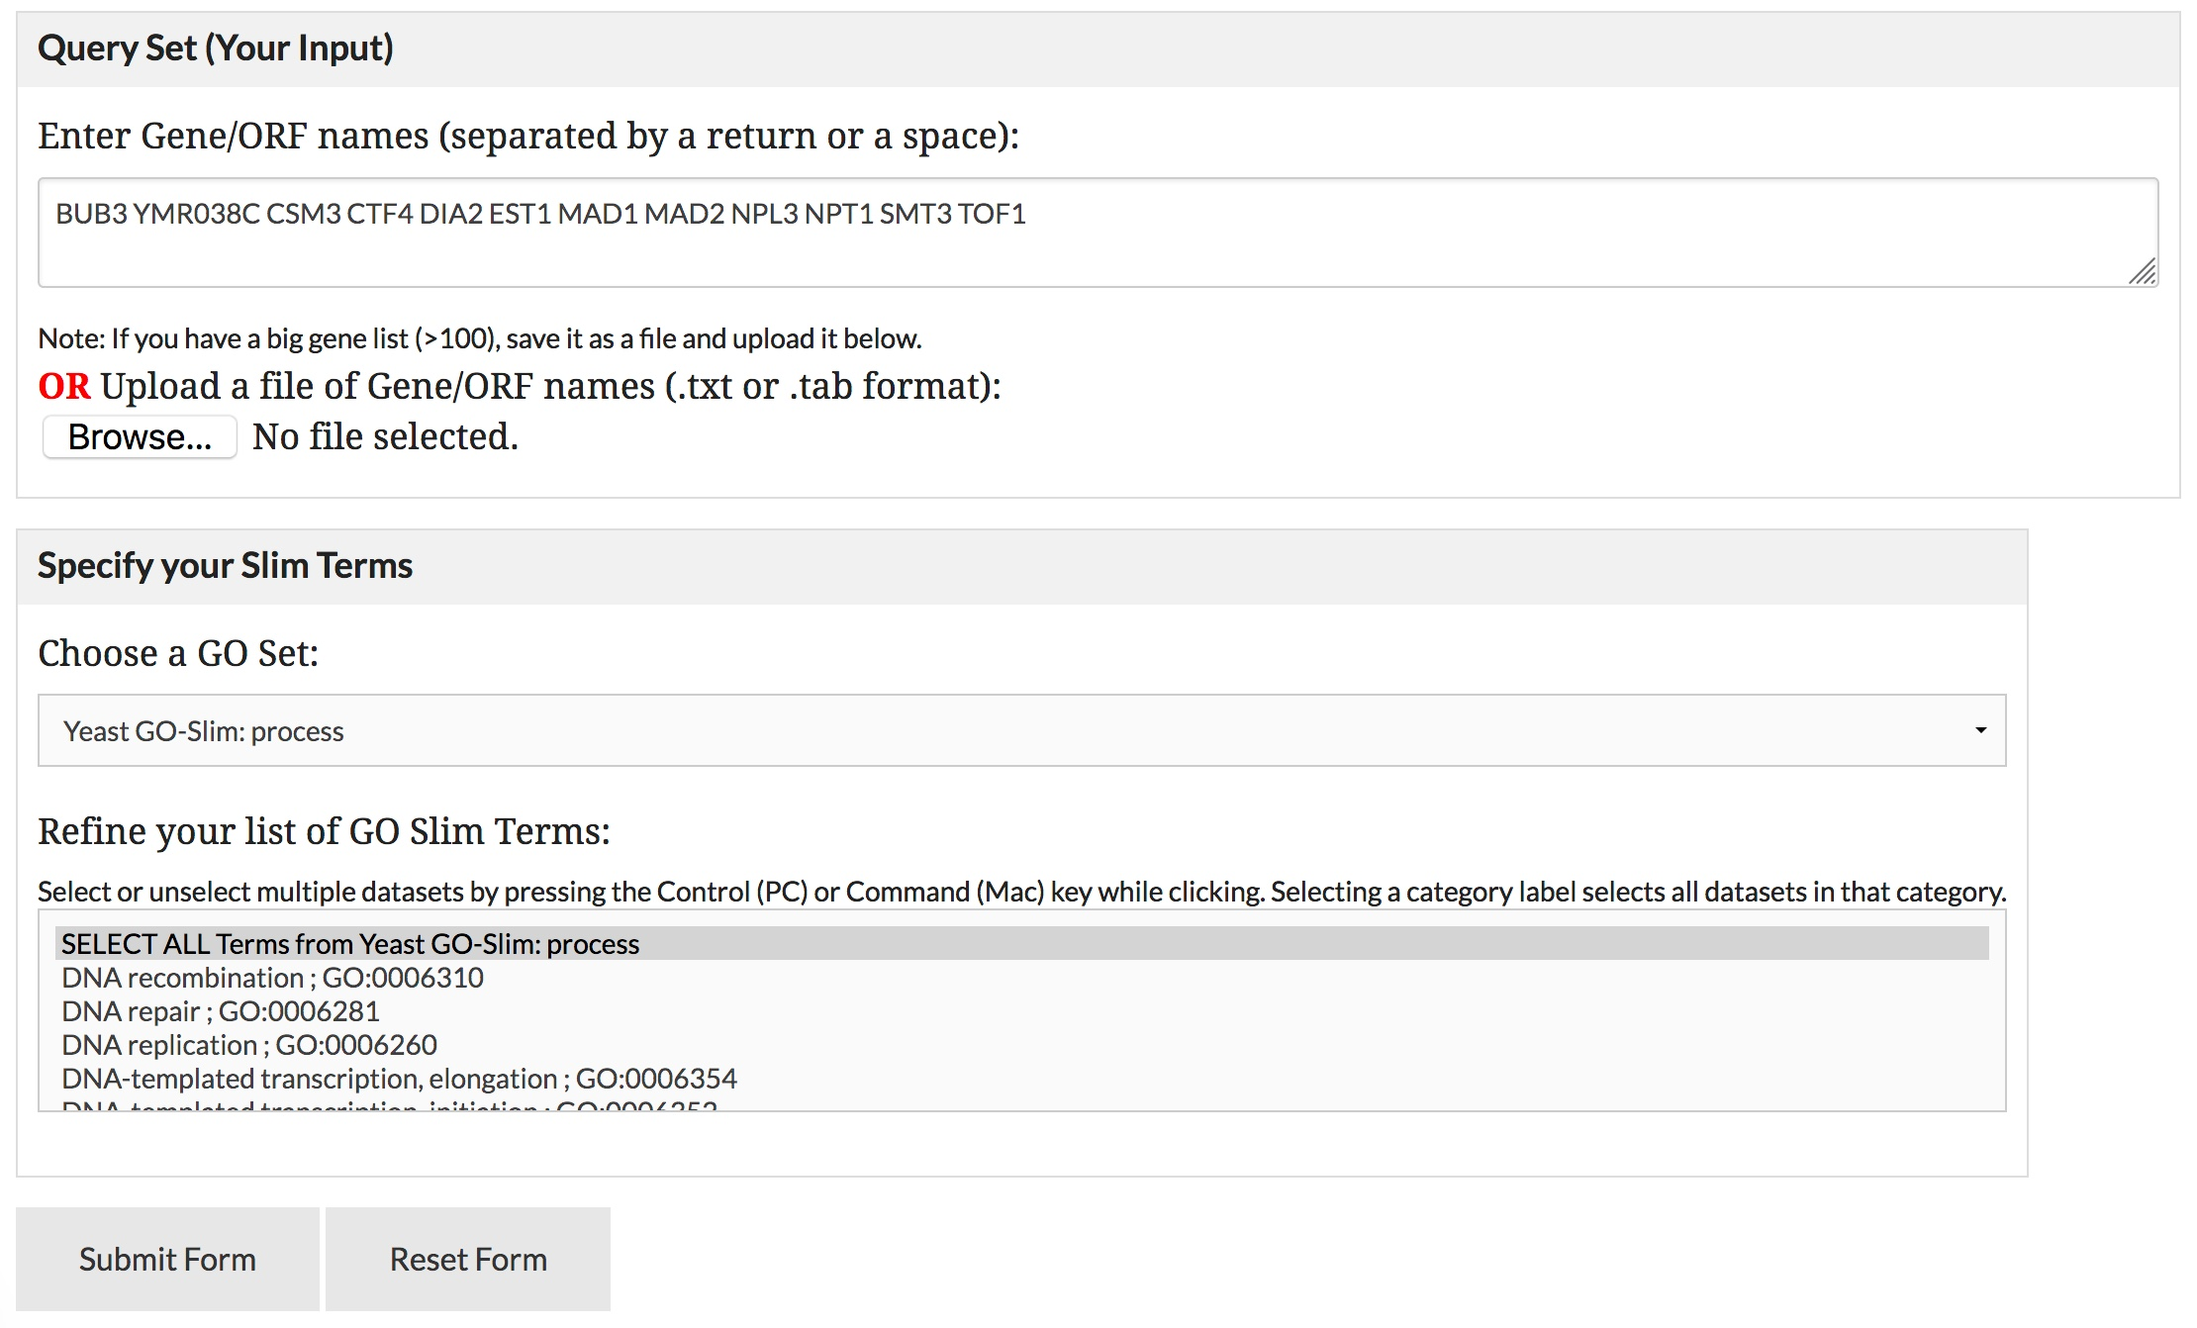
BUB3
CSM3
CTF4
DIA2
EST1
MAD1
MAD2
NPL3
NPT1
SMT3
TOF1
YMR038C

Slide 16
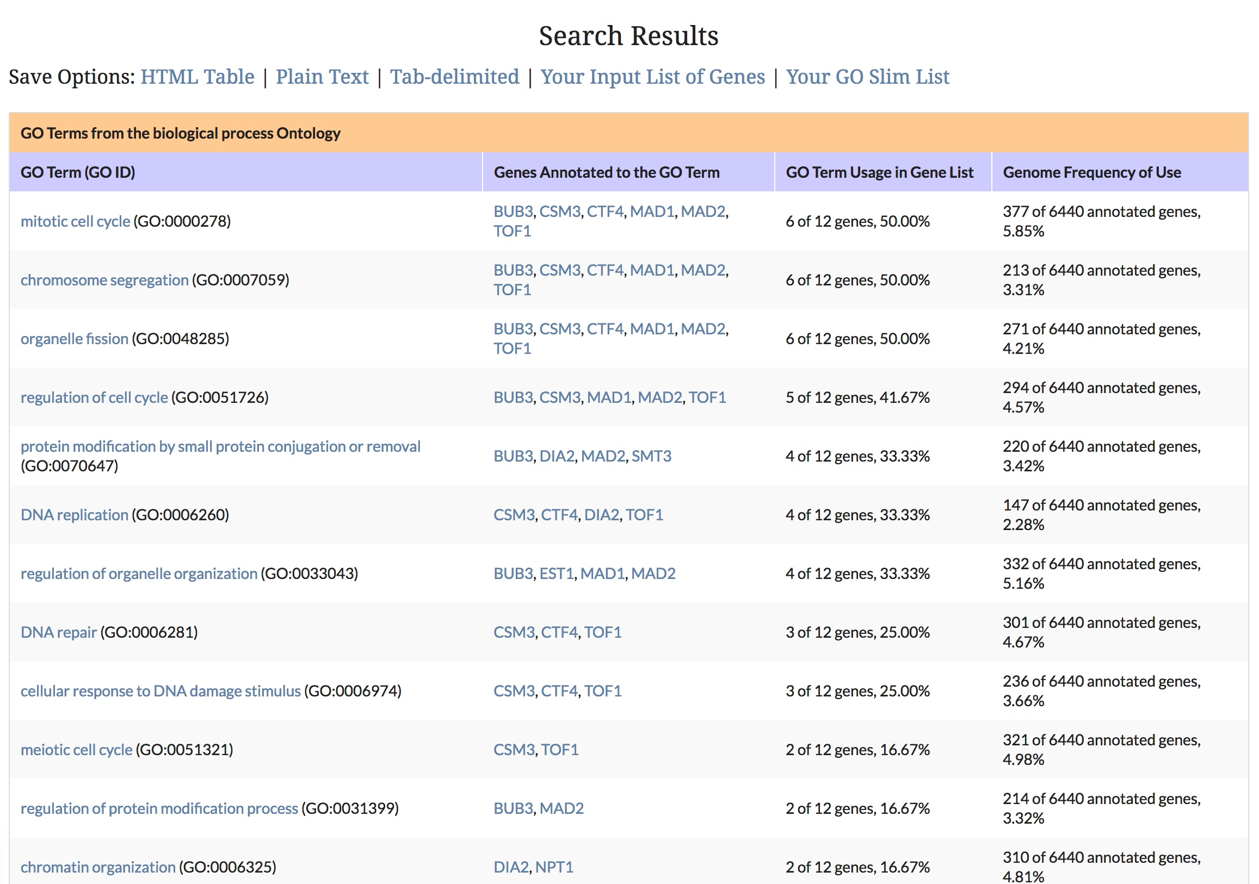

Slide 21
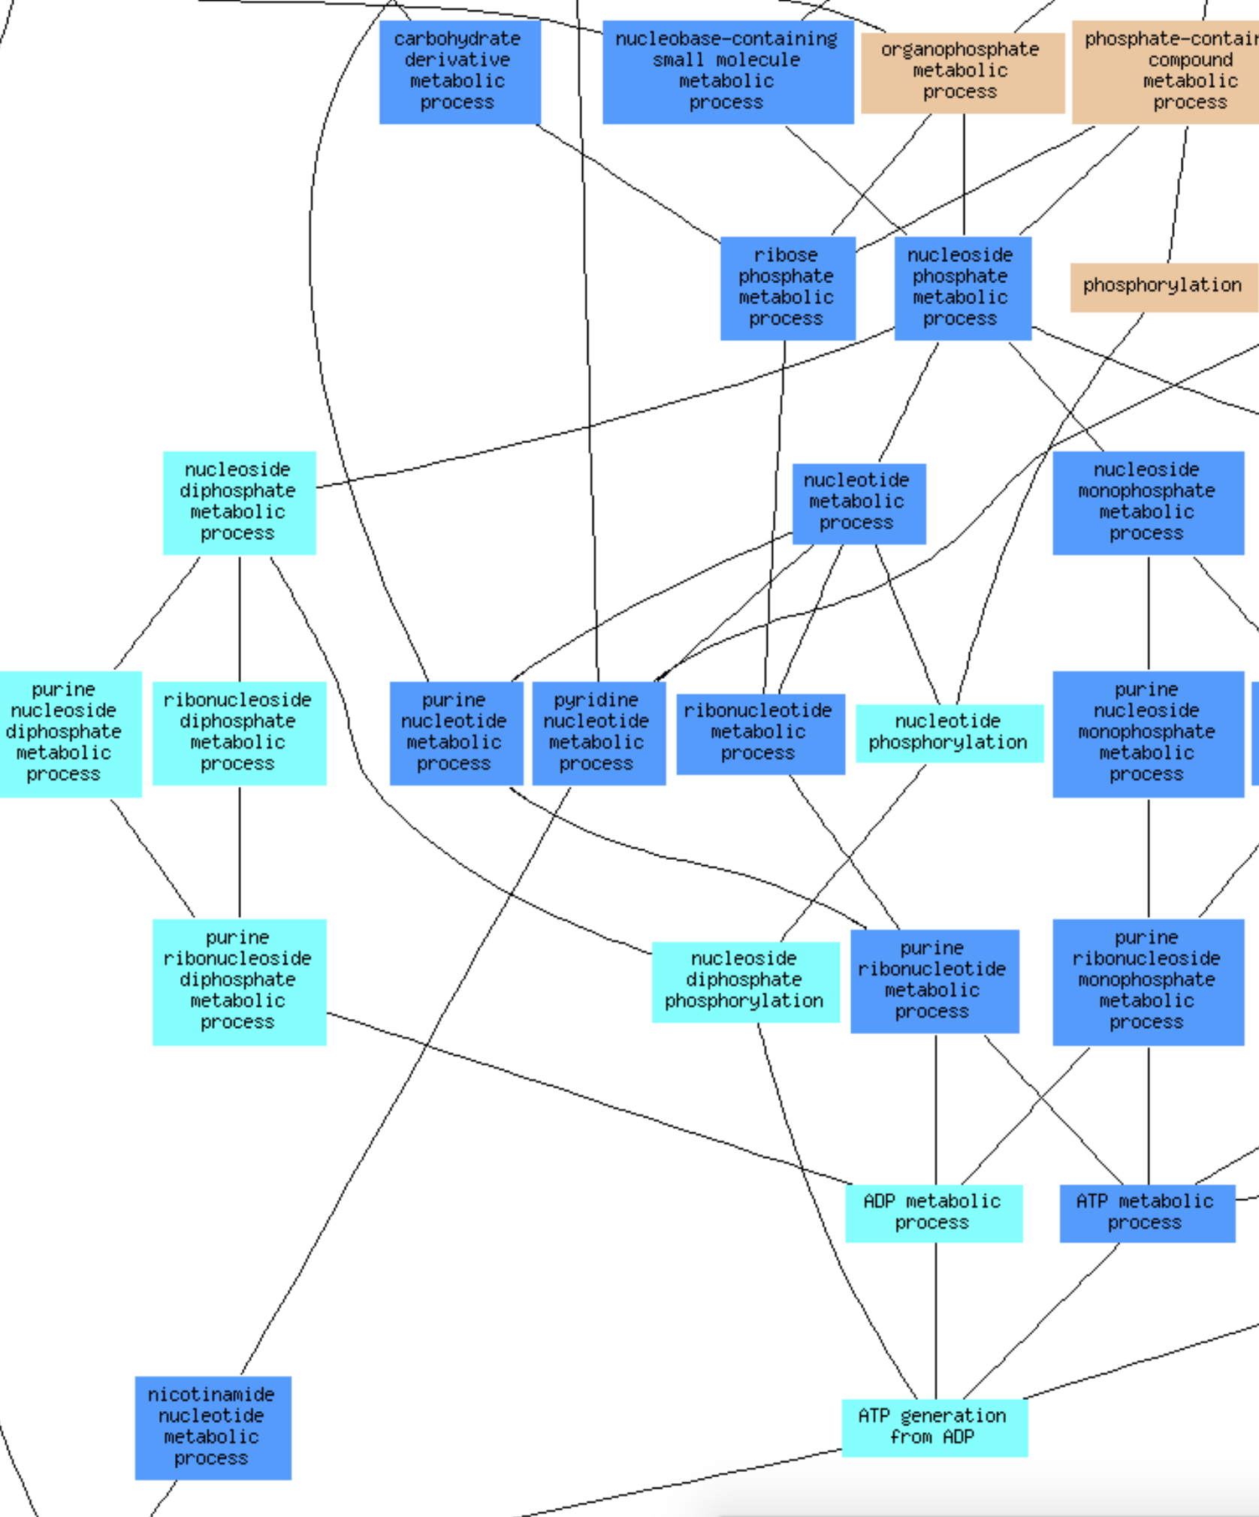
GO Term Finder yeastgenome.org/goTermFinder
ENO2
TDH1
GLK1
Gene List
GO Term Finder
Associated Functions

Slide 22
Thank you!
SGD Website yeastgenome.org Questions/Comments sgd-helpdesk@lists.stanford.edu YouTube Channel youtube.com/SaccharomycesGenomeDatabase
Download this presentation
bit.ly/ICYGMB2019
yeastgenome
@

