Slide 1
Yeast - why it simply has a lot to say about human disease

Slide 2
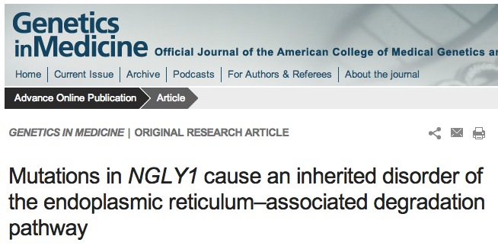
Genetic mutations identified in human disorders

Slide 3
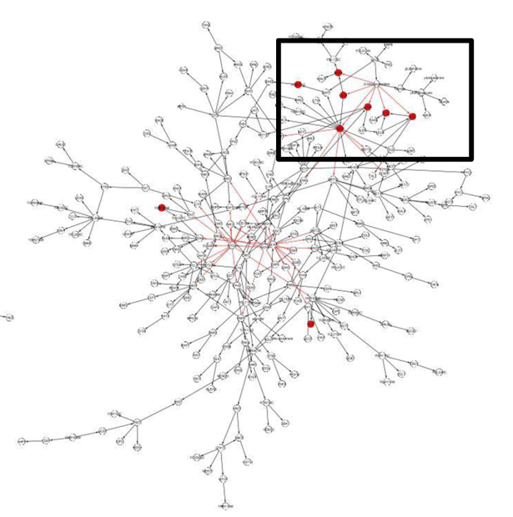
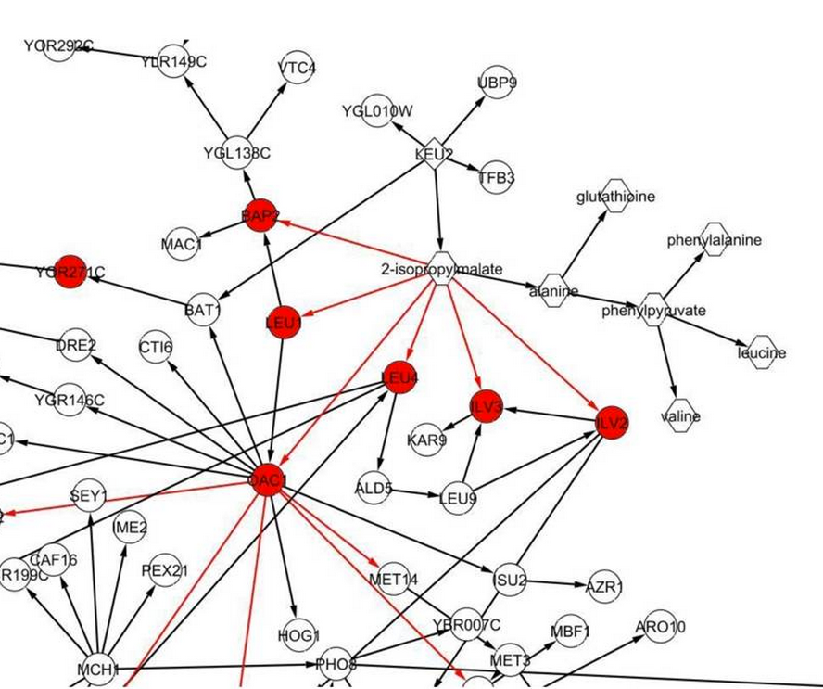
A richness of data allows yeast to tell a multi-dimensional story
genes
metabolites
Leu3p binding sites
genes w/cis-eQTLs
Zhu, et al. (2012), Stitching together multiple data dimensions reveals interacting metabolomic and transcriptomic networks that modulate cell regulation. PLoS Biology

Slide 4
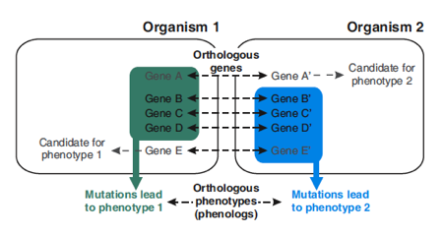
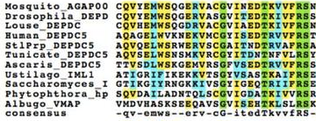
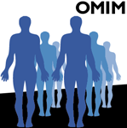
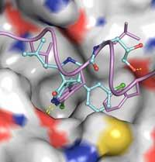
Human connections into SGD
Homology
& Disease
Phenotypes & Orthology
X
Functional
Complementation
Drug
Interactions
Literature

Slide 5
Searchable Connections
gene name

Slide 6
Searchable Connections
yeast gene

Slide 7
Searchable Connections
human gene

Slide 8
Searchable Connections
disorder

Slide 9
A real and present connection

Slide 10
A real and present connection
SGD’s Advanced Search
NGLY1

Slide 11
A real and present connection
SGD’s Advanced Search
NGLY1
phenotypes
yeast
PNG1
pathways
genetic interactions
literature
function
protein properties

Slide 12
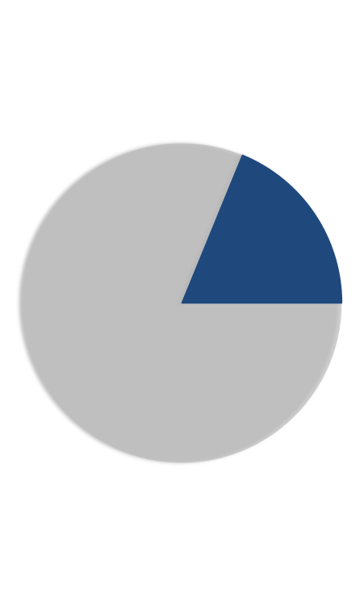
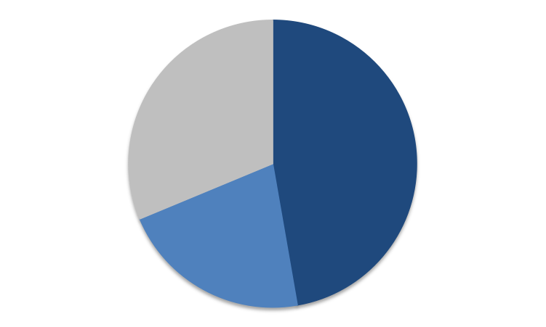
Connection start points
Human genes
Yeast genes
4500 genes
1340 diseases
2750
genes
Function known,
human homologs
Yeast homologs

Slide 13
SGD: Powering Connections

